Slide 1

This presentation is the intellectual property of Ken Chapman & Associates, Inc. It may not be modified or distributed in any format without expressed written permission from
Ken Chapman & Associates, Inc.
Copyright 2024. All rights reserved.

Slide 2
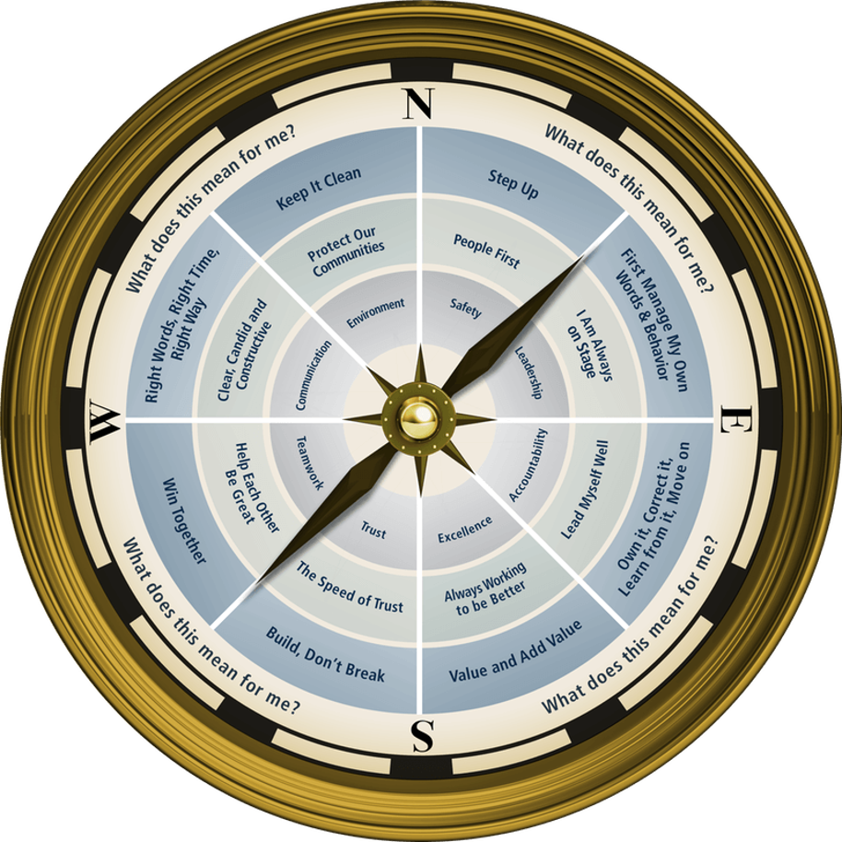

Session One: Leadership
Ken Chapman and Associates, Inc. All Rights Reserved
Not Licensed for Use Outside McWane, Inc.

Slide 3

Work Experience
Think back to your earliest experience of earning money for work you’ve done.
Include everything from your earliest job – babysitting, bagging groceries, mowing lawns – up to the present.
On your index card, write the total number of years you have been paid to work.
Do not include your name.
26

Slide 4

Who’s Aboard?
Introduce the Person to Your Right
Tell us:
The person’s name
Their job description and/or position
Something interesting about the person

Slide 5
McWane Professional Development Objectives
Reaffirm the importance of The McWane Way.
Further develop a work setting which supports the McWane business model: Safety, Environment, Quality Production, and Profit
Establish The Speed of Trust across departments
Recognize pride of workmanship – the value each team member brings to McWane.

Slide 6

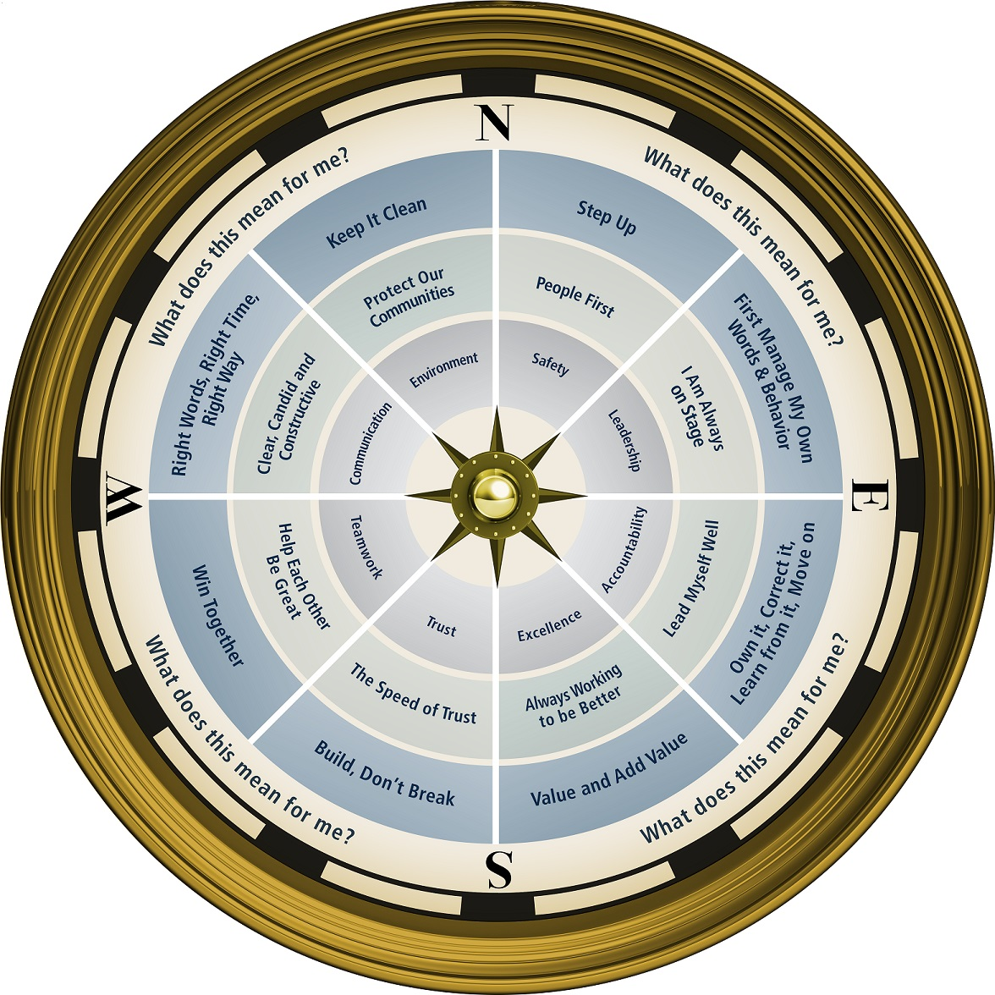


Slide 7
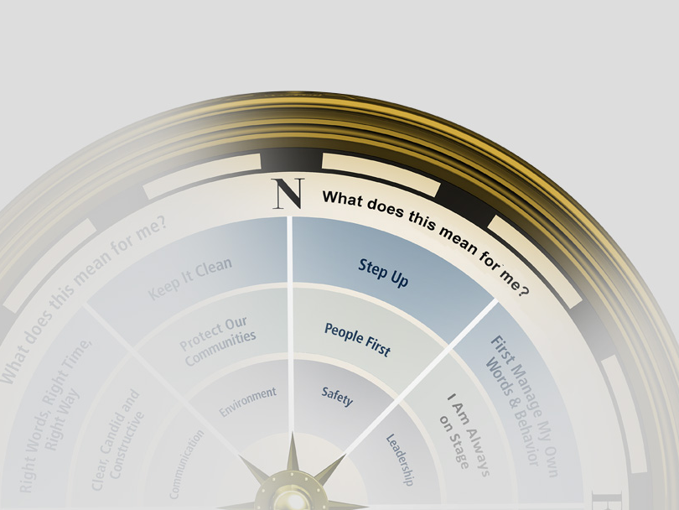

Slide 8


Are These Session Standards Agreeable?
Silence cell phones.
No “active” email & texting.
If it’s necessary to take a call or return a message, please leave the room. Step away so that your conversation does not interrupt the team discussion.
Refrain from side conversations.
Personal stories or examples shared by team members remain in this room.

Slide 9

Making the Most of the Time Invested
We ask you to do the following:
Keep an open mind
Notes:
9

Slide 10
How Many Boxes Do You See?

Slide 11
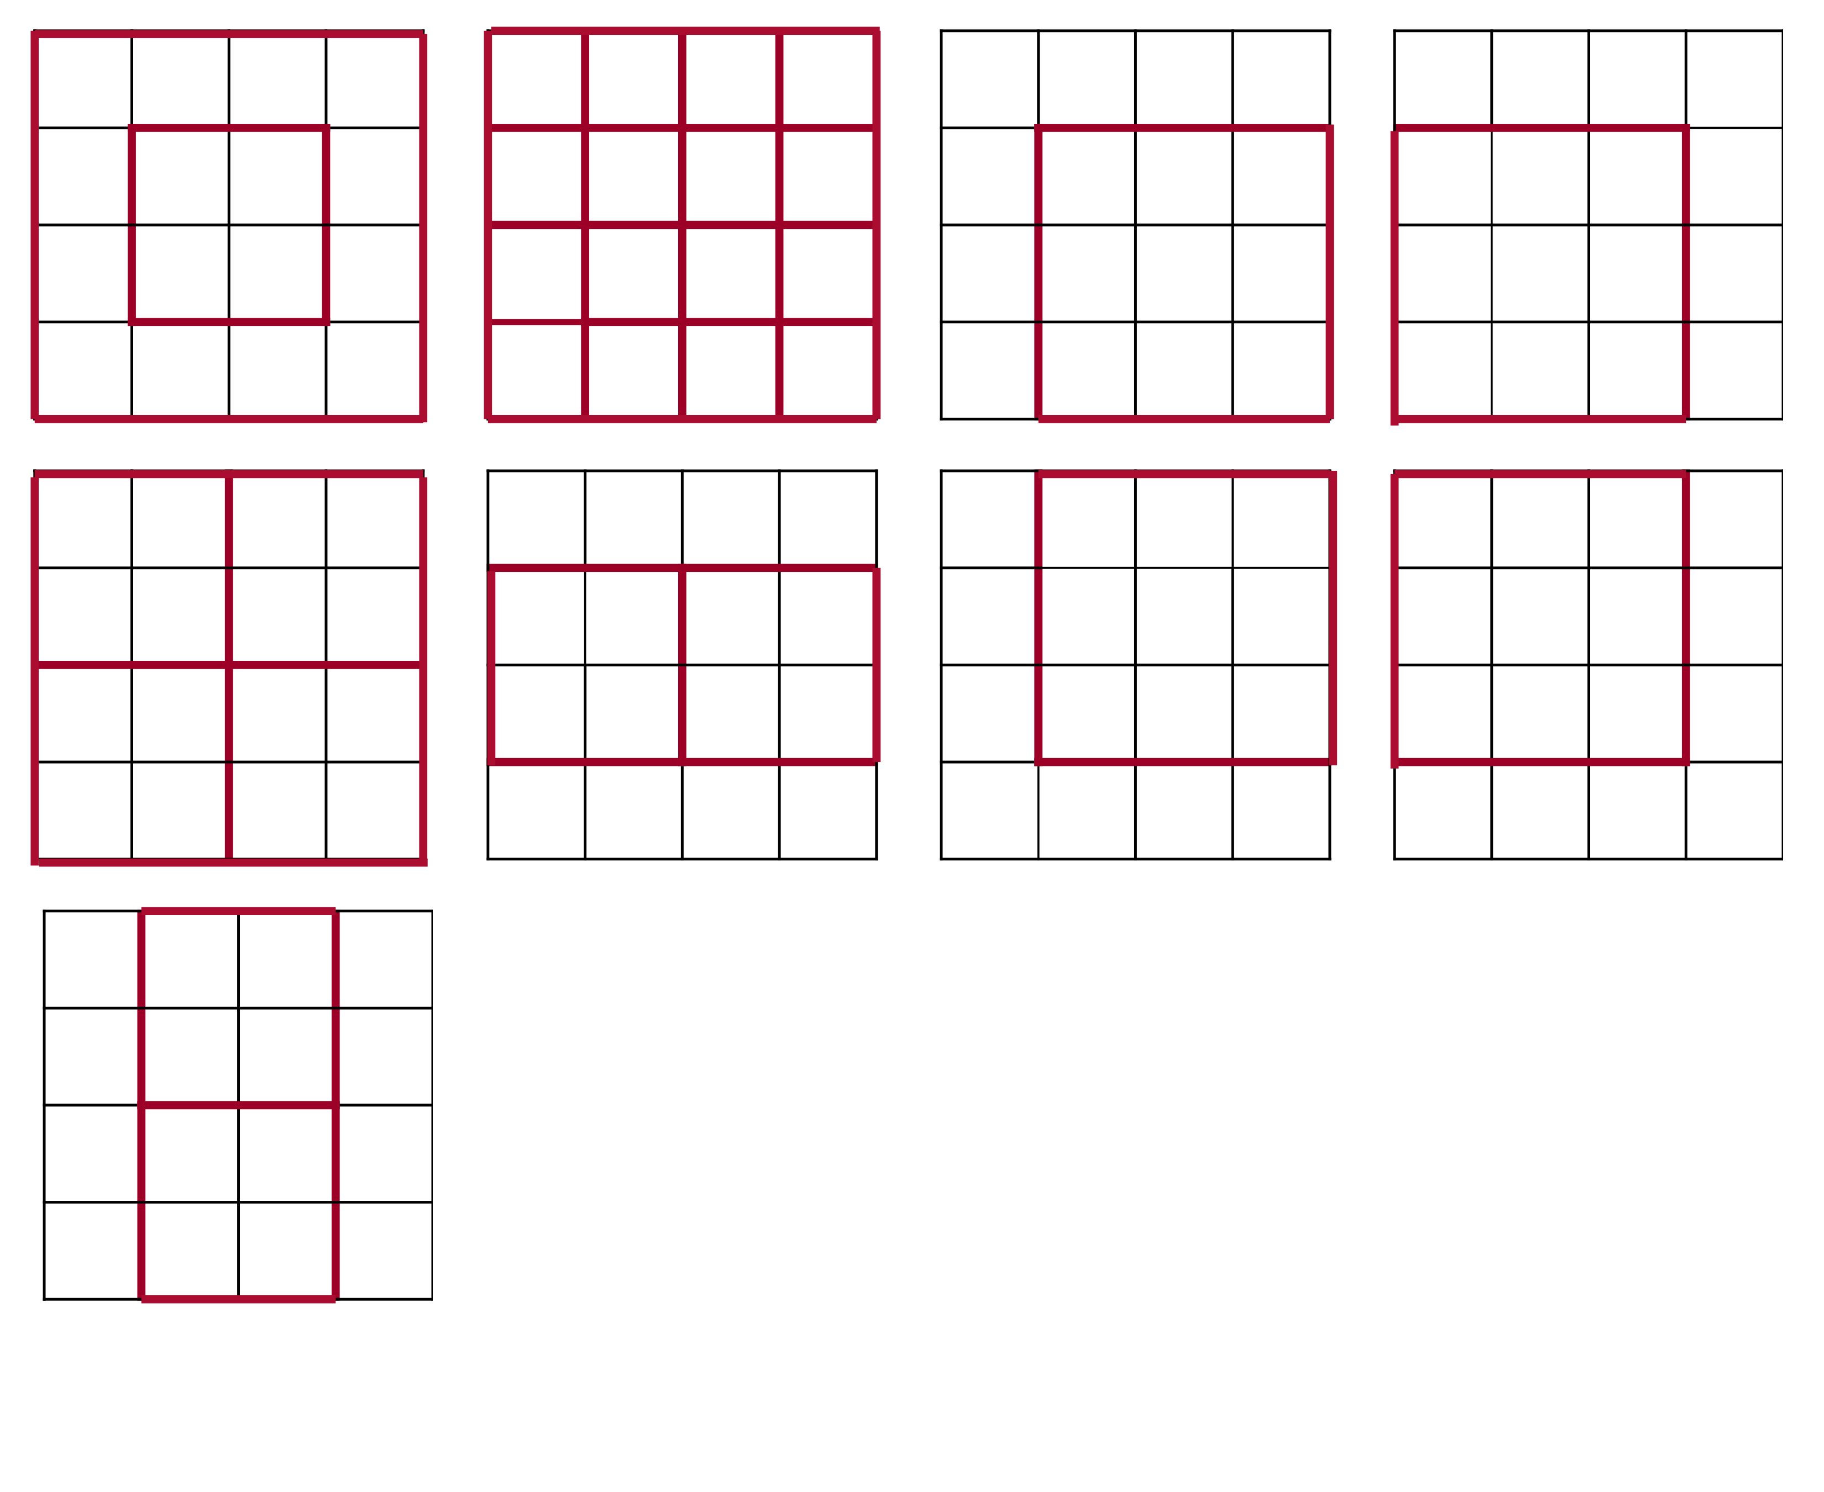
30 Boxes In Plane View

Slide 12
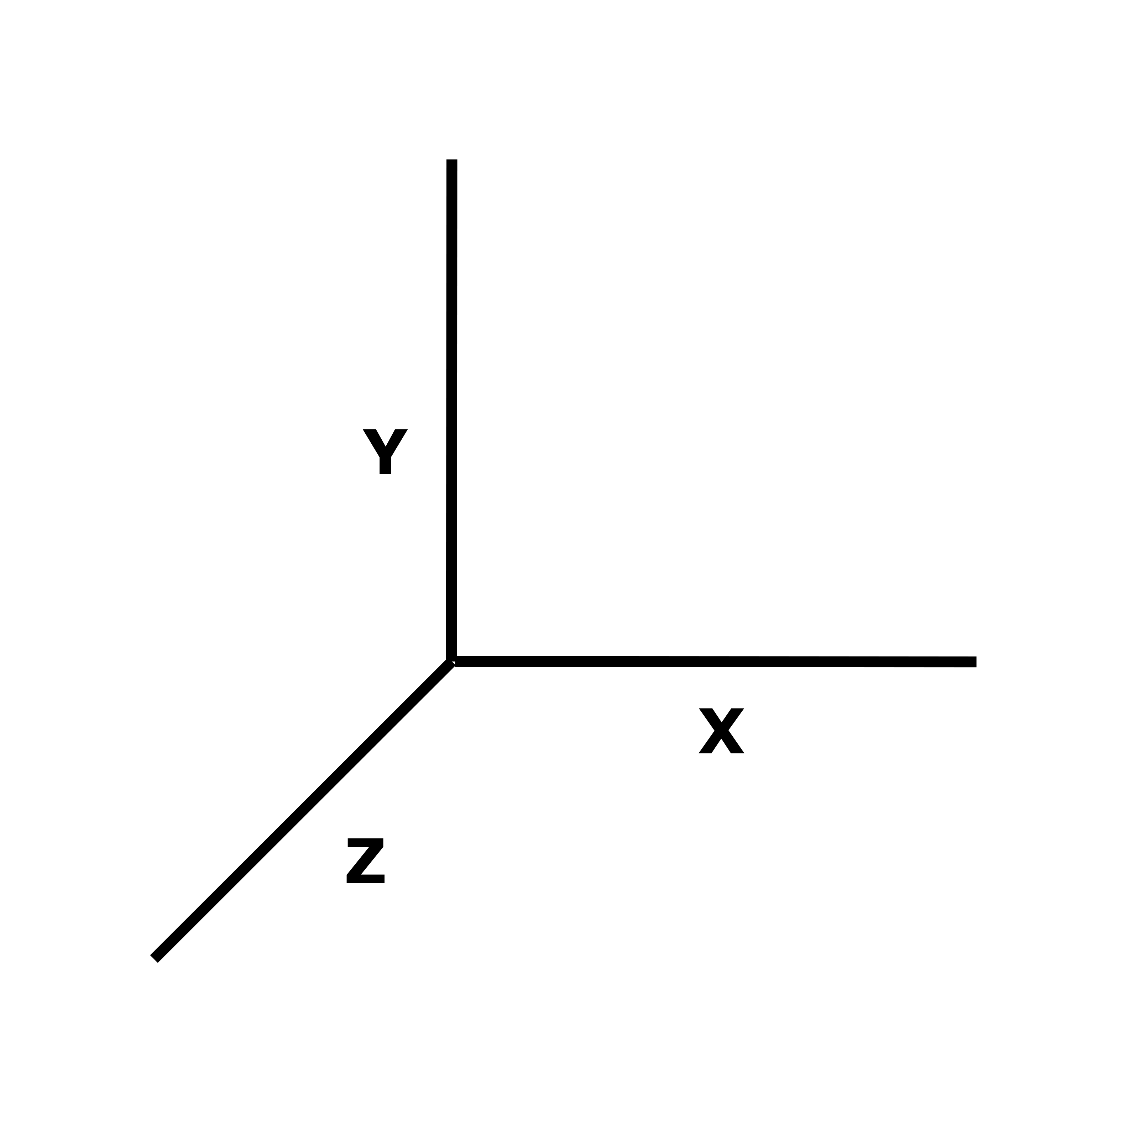

4 Slices x 3 Plane Views = 12 Total Slices
x 2 Sides/Slice = 24 Total Sides
X 30 Boxes/Side = 720 Total Boxes

Slide 13

Making the Most of the
Time Invested
We ask you to do the following:
Keep an open mind
Ask questions and challenge what you hear
Take notes and complete assignments
Relax and have fun
Notes:
13

Slide 14
The [CLIENT LOCATION] Team
The number one reason people come through the gate at [CLIENT LOCATION] is for what their efforts will provide for the people they care about outside the gate.
In your teams, discuss what this statement means to you.
Assign a team member to report out.
Notes:
14

Slide 15
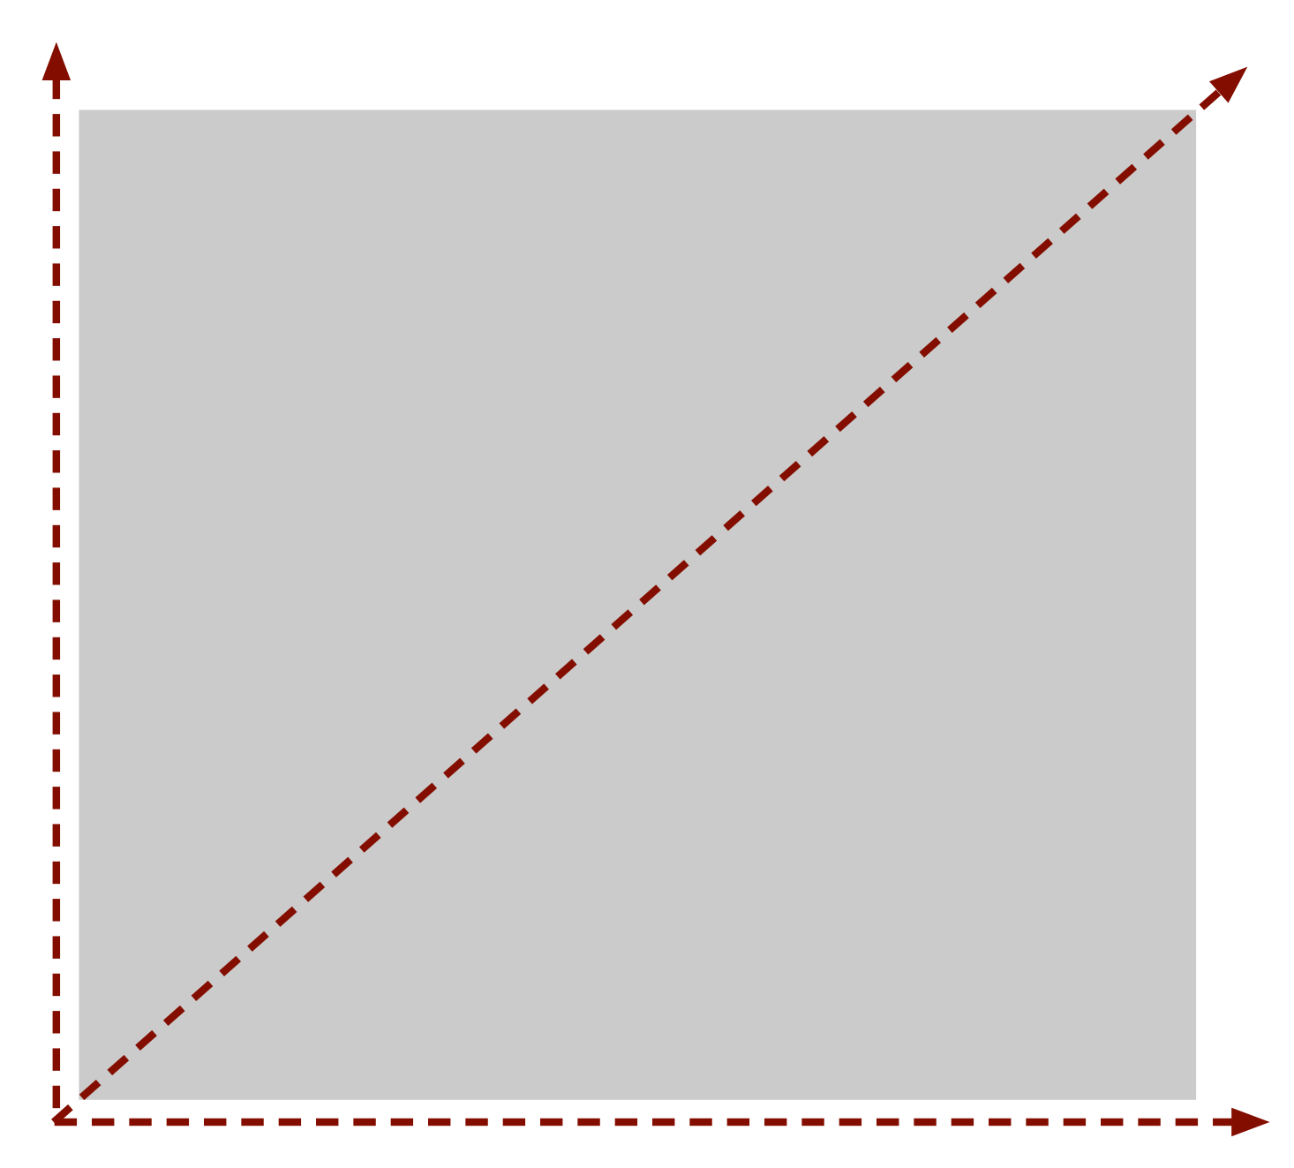
The [CLIENT LOCATION] Team
Win-Win
[CLIENT LOCATION]’s interest
What is the most important thing [CLIENT LOCATION] can do for its team members?
What is the most important thing a team member can do for [CLIENT LOCATION]?
My interest
Notes:
15

Slide 16
The [CLIENT LOCATION] Team
50% of the general population do not think about where they’ve been, where they are, and where they’re going.
Two-thirds of the general population do not have real-time awareness of their emotions.
Two-thirds believe they are good listeners, and two-thirds believe no one ever listens to them.
Notes:
16

Slide 17
The [CLIENT LOCATION] Team
How does the following contribute to personal success and happiness?
1. Thinking about where you want to go
2. Being aware of one’s emotions in real time
3. Listening for what is important to others
Select a team member to present your team’s thoughts.
50% of the general population do not think about where they’ve been, where they are, and where they’re going.
Two-thirds of the general population do not have real-time awareness of their emotions.
Two-thirds believe they are good listeners, and two-thirds believe no one ever listens to them.
Notes:
17

Slide 18
The [CLIENT LOCATION] Team
Everybody wants their story to be a good story.
Others help those who help them.
People do not want to be impressed … they want to be valued.
People want to choose what is in their best interest.
If you knew the story, you’d discover that most people have lived heroic lives.
The people make a company an engine for good in the community.
Notes:
18

Slide 19
The [CLIENT LOCATION] Team
You and all other team members
benefit from [CLIENT LOCATION]. How?
Who else benefits from [CLIENT LOCATION]?
How does the community benefit from
[CLIENT LOCATION]?

Slide 20
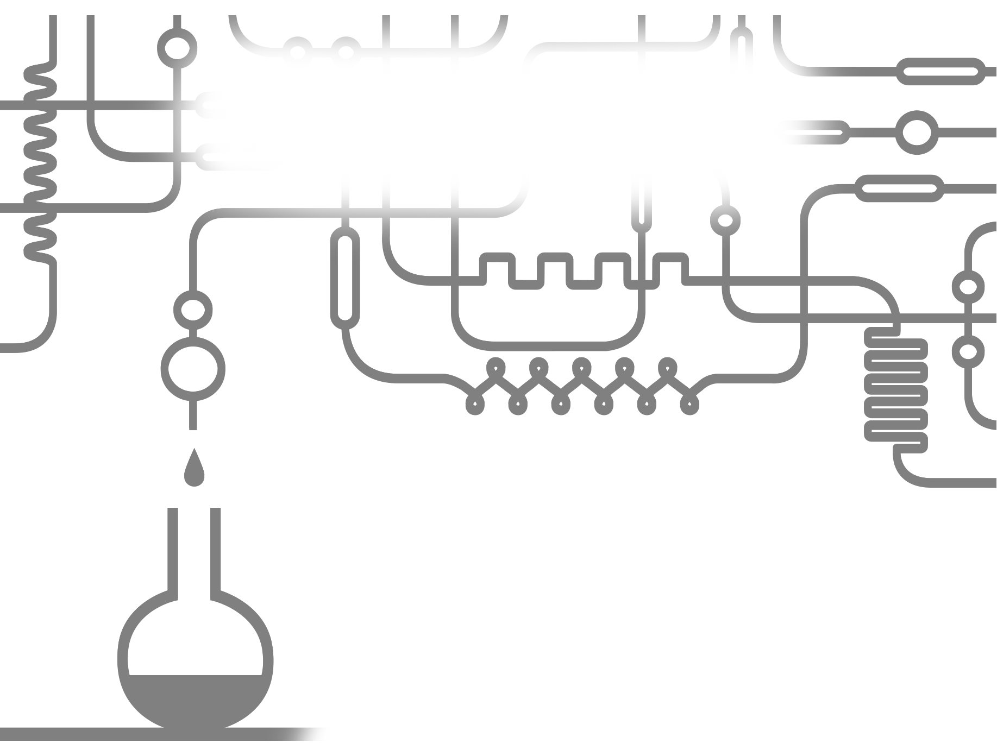
The Ideal Team Member
If you could go into a lab and design the ideal [CLIENT LOCATION] team member, what characteristics would that person have?
Working in your teams, create a list of characteristics to describe
“The Ideal [CLIENT LOCATION]
Team Member”.
Team Member
Then choose a team member
to present for your team.

Slide 21
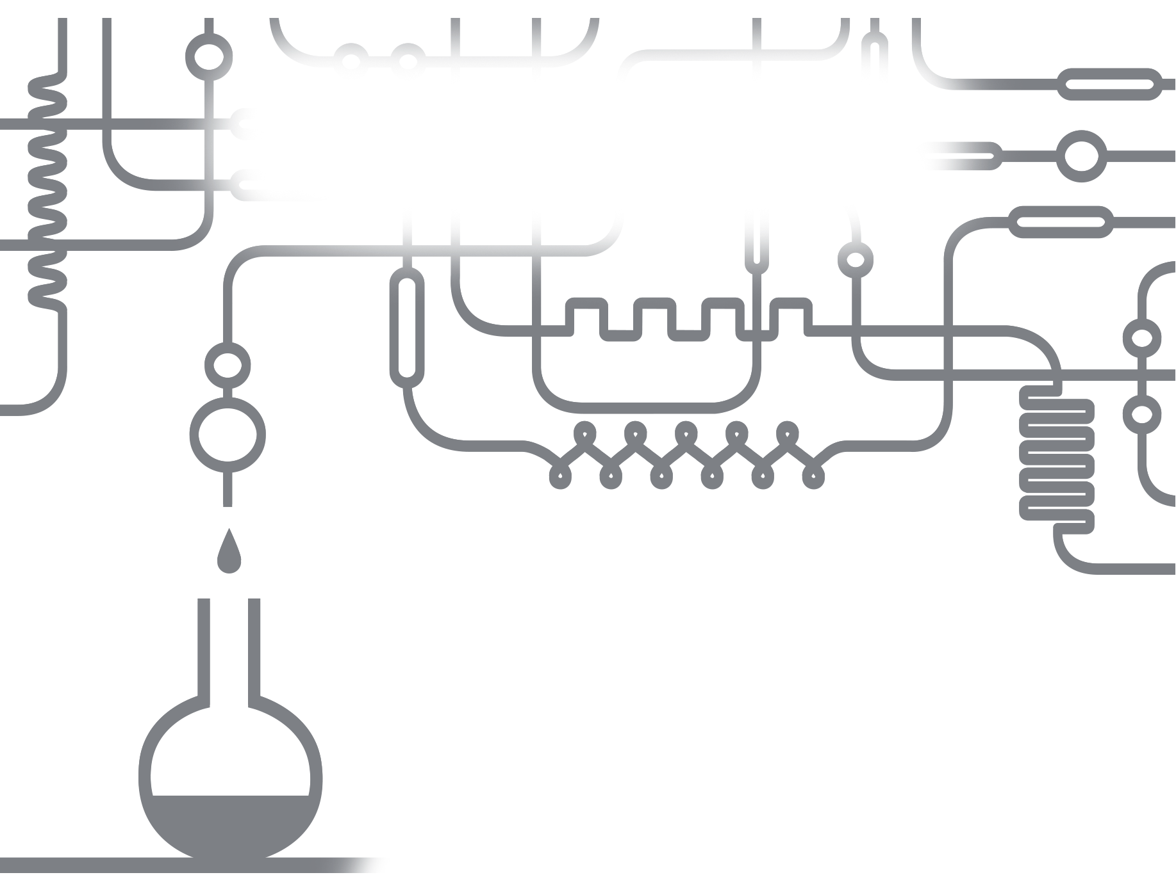
Ideal Team Member Characteristics
Rate your own performance on each characteristic as of today.
1 2 3 4 5
Poor Excellent
1. _____________________
1 2 3 4 5
Poor Excellent
2. _____________________
1 2 3 4 5
Poor Excellent
3. _____________________
1 2 3 4 5
Poor Excellent
4. _____________________
1 2 3 4 5
Poor Excellent
5. _____________________

Slide 22
The Ideal Team Member
How Smart is Smart Enough?
Fact Vs. Fiction
I.Q. Intelligence Quotient
How smart you are
A.I.Q. Applied I.Q.
Common Sense
E.I.Q. Emotional I.Q.
Capacity to read and monitor the human document in real time
Notes:
22

Slide 23

Reading Myself and Others (EIQ)
Myself:
  Body Language
  Facial Expression
  Tone
  Word Choice
Others:
  Body Language
  Facial Expression
  Tone
  Word Choice
Notes:
23

Slide 24


Slide 25
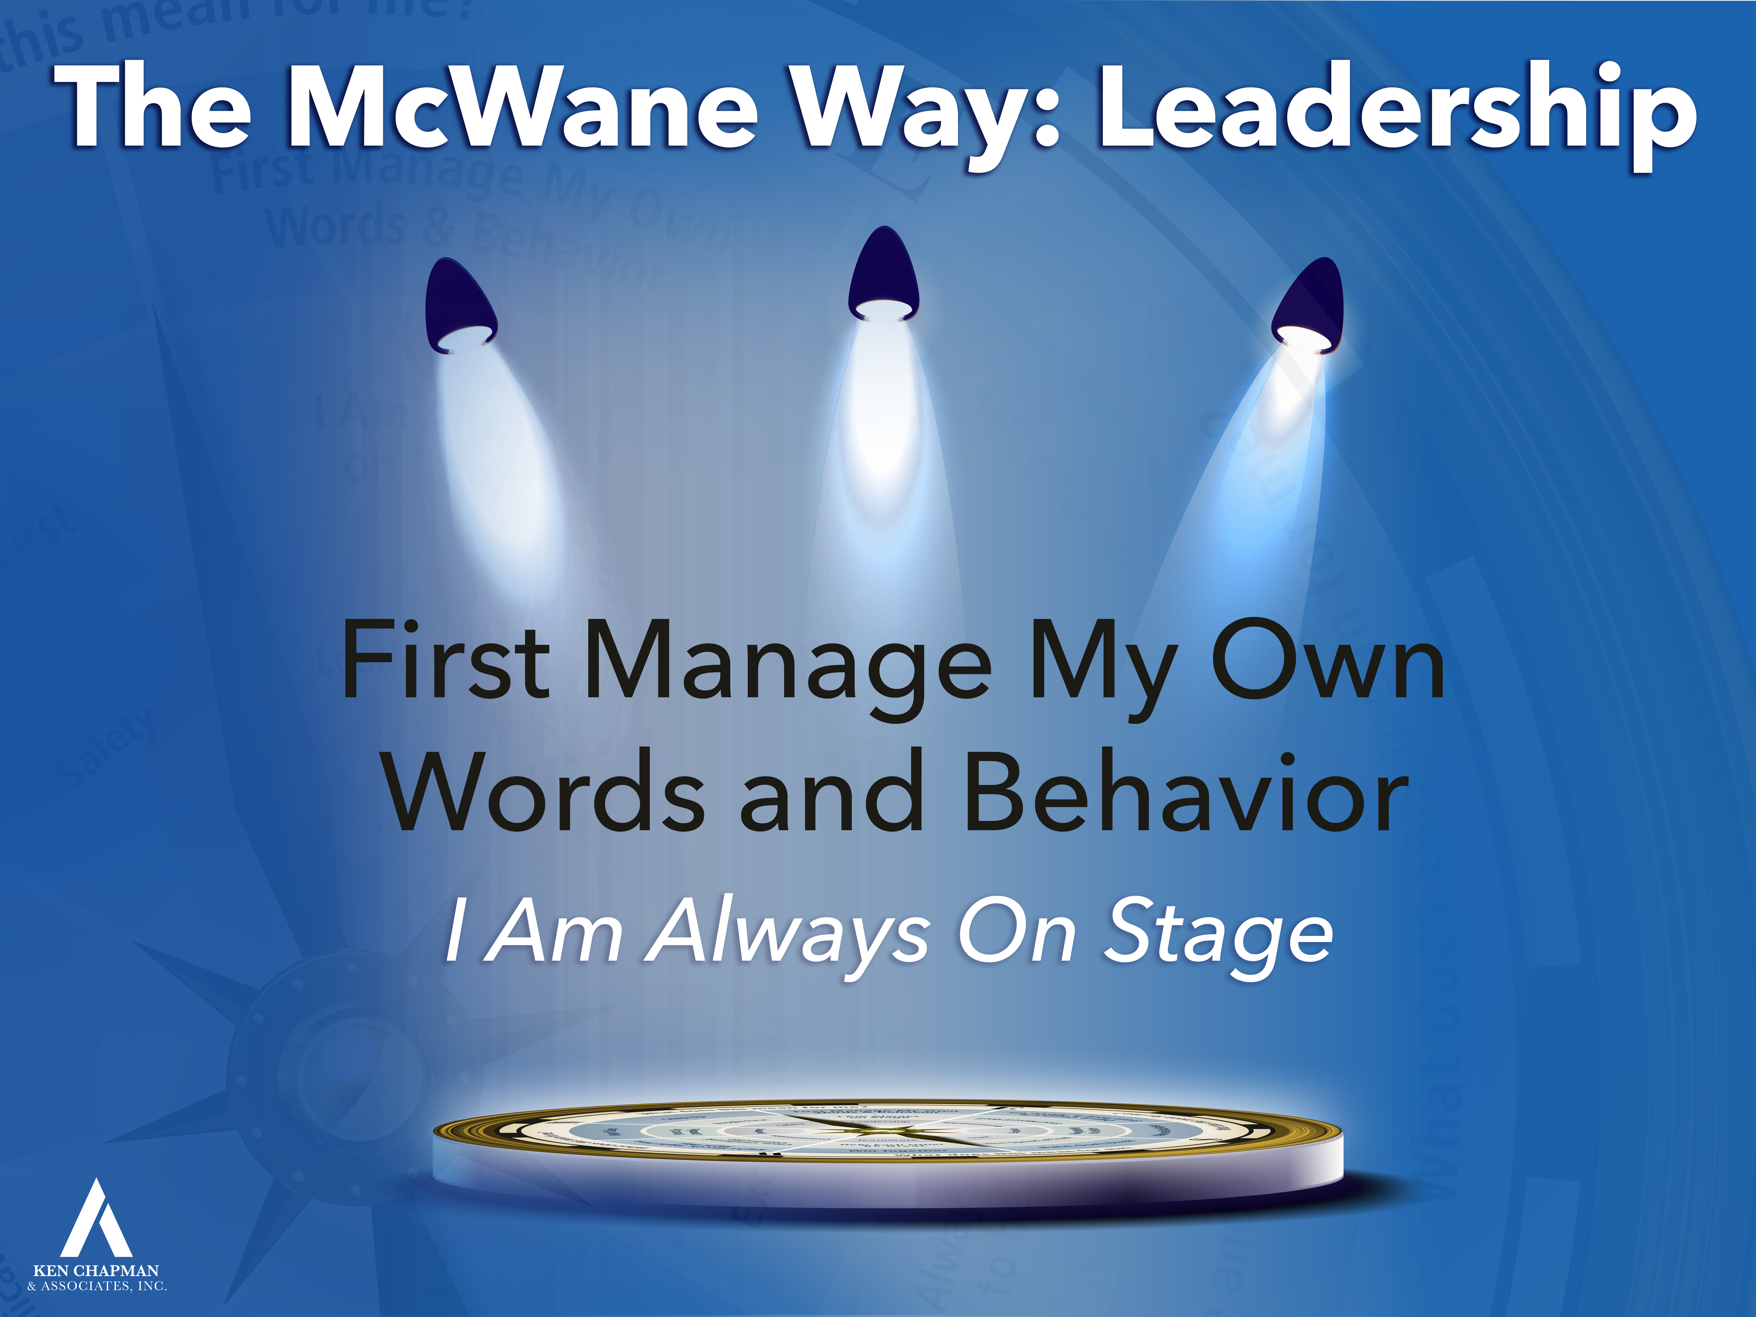

Slide 26
The Rationale for . . .
First Manage My Own Words and Behavior
Assumes control of the one thing I can always control – myself.
Grants me moral authority – I am already doing what I ask you to do.
Maximizes the trust and respect I have earned.
Walk the “Math Path”
Notes:
26

Slide 27

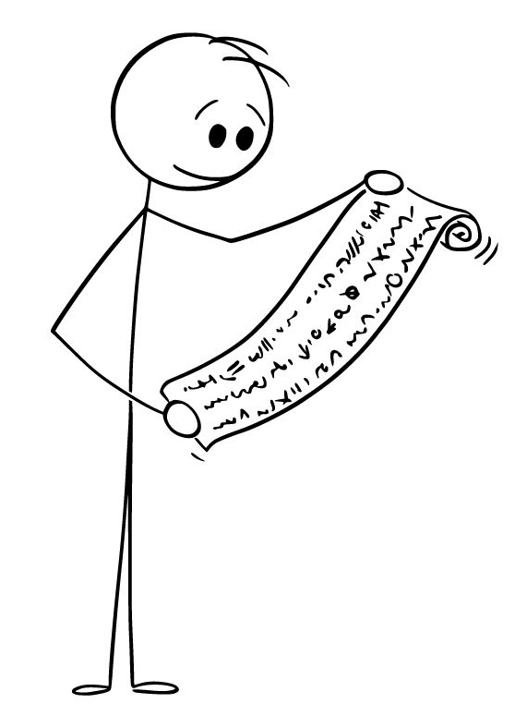
Walk The Math Path
Does the sum of my behaviors add up to a Good Example?
-
+
Well Done (+)
Opportunity (-)
+
-
+ Said the right thing
at the right time
- Used an inappropriate tone
+
+ Remained calm when others were upset
- Missed an opportunity to say the right thing
+ Stopped unsafe job
3
>
2
Notes:
When I add up my behavior will it take me on the path to reach the desired goal or objective?
It is direction not intent that determines destination. Since that is the case, does my behavior lead my team to the destination I want?
Ben Franklin kept a journal (moral ledger) where he recorded a ledger of his day.
When I “do the math” does it add up?
We are not looking for perfection, we are looking for a good outcome.
The logic behind this is that you list out all the things you did well and then all the items you wish you would have don’t a little bit better. The animations should be all “well done” in first, then all “opportunities.” The idea is NOT one good item, one bad item and so forth.
27

Slide 28
Opportunity Assignment
To Prepare for the Next Session:
Assignment:
1. Leadership Development Plan
How can I do a better job of being an
Ideal Team Member?
2. Read: The Leader’s Code
Chapters 1, 2, & 3
3. Today’s Story
What is a life or leadership lesson?

Slide 29

The Choice
What is a life or leadership lesson?

Slide 30
This presentation is the intellectual property of Ken Chapman & Associates, Inc. It may not be modified or distributed in any format without expressed written permission from
Ken Chapman & Associates, Inc.
Copyright 2024. All rights reserved.

