Slide 1

This presentation is the intellectual property of Ken Chapman & Associates, Inc. It may not be modified or distributed in any format without expressed written permission from
Ken Chapman & Associates, Inc.
Copyright 2024. All rights reserved.

Slide 2


Session Two: Accountability
Ken Chapman and Associates, Inc. All Rights Reserved
Not Licensed for Use Outside McWane, Inc.

Slide 3
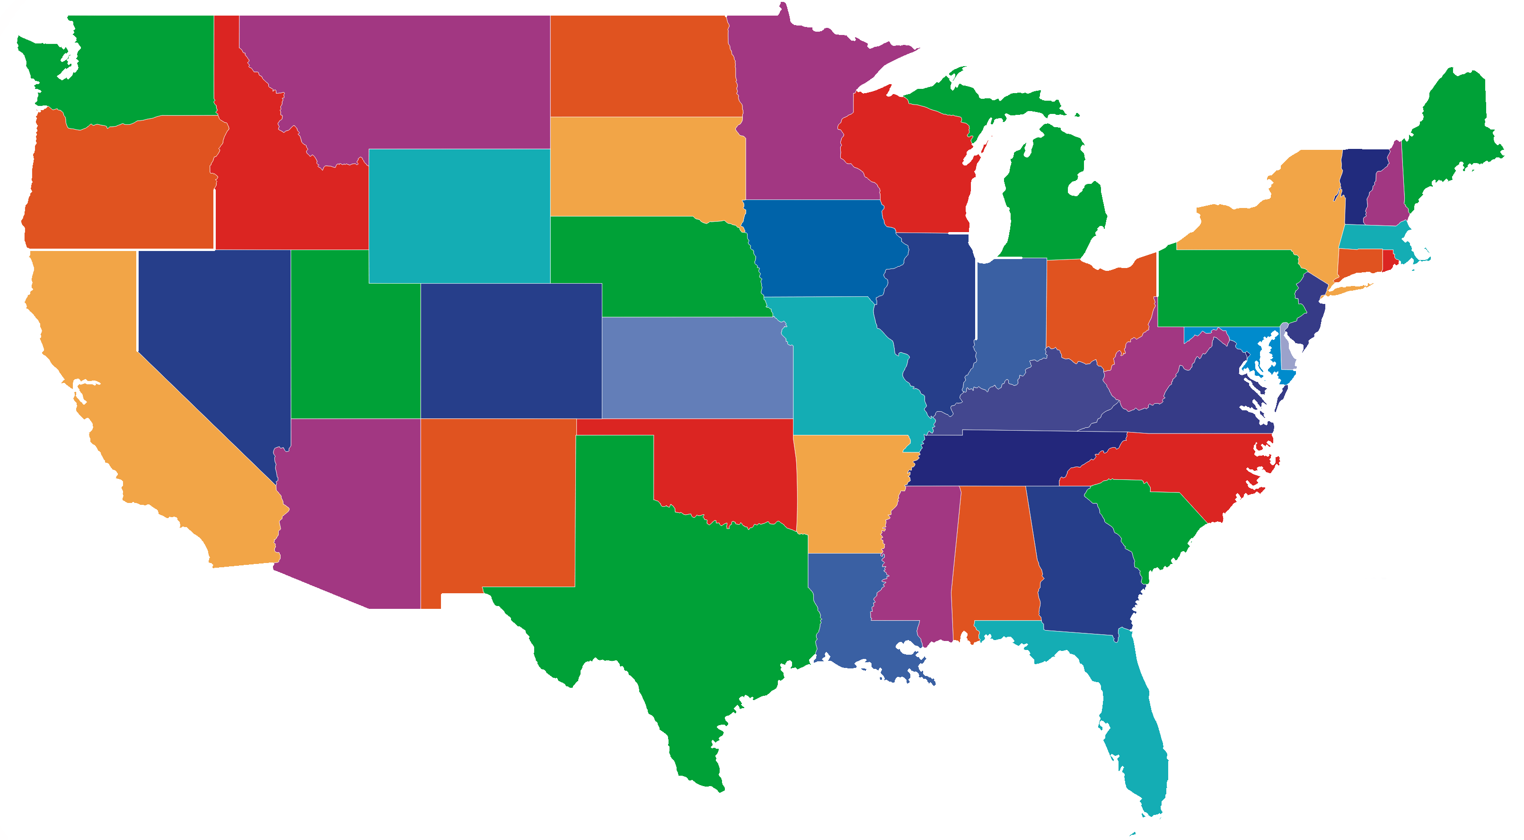

State Nicknames
Notes:
3

Slide 4

What is Idaho’s nickname?
Potato Wonderland
Gem State
Northern Light
Garden of Paradise

Slide 5

What is Louisiana’s nickname?
Bluegrass State
Treasure State
Pelican State
Pine Tree State

Slide 6

What is Mississippi’s nickname?
Crossroads of
the South
Land of Opportunity
Magnolia State
Heart of Dixie

Slide 7

What is the "Sunflower State?"
Kansas
Tennessee
Oklahoma
Missouri

Slide 8

What is the "Evergreen State?"
Vermont
Washington
Oregon
Georgia

Slide 9

Maryland has two nicknames.
One is "The Old Line State."
What’s the second?
Crab Sanctuary
Oriole
Star Spangled State
Free State

Slide 10

What's New Jersey’s nickname?
Garden State
Highways to Heaven
Eastern Wonderland
Shore to Please

Slide 11

What is the "Hawkeye State"?
Illinois
Iowa
Ohio
Indiana

Slide 12


Session Standards
Confirmed in Session One
Silence cell phones.
No “active” email & texting.
If it’s necessary to take a call or return a message, please leave the room. Step away so that your conversation does not interrupt the team discussion.
Refrain from side conversations.
Personal stories or examples shared by team members remain in this room.
Notes:
12

Slide 13

The Ideal Team Member
Rate your own performance on each characteristic as of today.
1 2 3 4 5
Poor Excellent
1. _____________________
1 2 3 4 5
Poor Excellent
2. _____________________
1 2 3 4 5
Poor Excellent
3. _____________________
1 2 3 4 5
Poor Excellent
4. _____________________
1 2 3 4 5
Poor Excellent
5. _____________________
Notes:
13

Slide 14
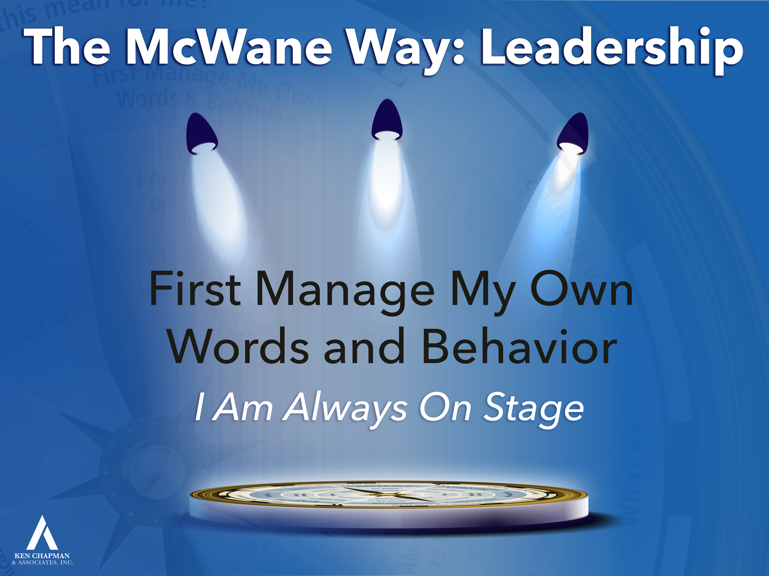

Leadership Development Plan:
First manage my own words & behavior
You were asked to set a goal from Session One focused on “How can I do a better job of being an Ideal Team Member?”
Please briefly share your goal and how it is going.
Notes:
14

Slide 15
Team Discussion
Opportunity Assignment Roundtable
The Leader’s Code
You were asked to read Chapters 1, 2 & 3.
Working in your teams, discuss the passage assigned
to your team.
What does this mean for you and your team?
Record your thoughts on paper.
Appoint a spokesperson for your team.
Notes:
15

Slide 16
The Leader’s Code
The Hero Within
Quote #1
For most people, their work is not just work. It is very important to them. It expresses and supports their need to matter – to be valued and make sense out of things.
[Chapter 1, Page 2]
Notes:
How does pride in what you do create better outcomes?
16

Slide 17
The Leader’s Code
The Hero Within
Quote #2
We want our time and lives to matter. With that in mind, all human beings share two basic needs: the need to be valued and the need to make sense out of things.
[Chapter 1, Page 2]
Notes:
Is it your experience team members want to be recognized for the work they do?
How does it impact your performance when you know what is expected of you?
17

Slide 18
The Leader’s Code
The Fool’s Errand
Quote #3
When you believe you matter, the chaos can quickly become superior performance. But first, people must believe they matter. This is the magic of the human heart. Discretionary energy is the magic a person brings to the people and places where their best efforts are valued.
[Chapter 2, Page 15]
Notes:
How does it impact your performance when you feel valued and appreciated?
18

Slide 19
The Leader’s Code
The Leader Within
Quote #4
Personal integrity is a glass house each person builds over a lifetime. Our willingness to do the right thing openly and reliably determines how bulletproof the glass will be. Pete shot out his own windows. Or, to put it another way, Pete shot himself in the foot.
[Chapter 3, Page 22]
Notes:
19
Have you observed events or occasions when someone did something at work which was contrary to their best interest?
How did that work out for them?

Slide 20
The Leader’s Code
The Leader Within
Quote #5
Having a roadmap is the beginning of personal and organizational leadership. The road map clearly identifies the principles by which I choose to live. It provides overall direction. It gives my life and work purpose and meaning.
[Chapter 3, Page 23]
Notes:
If I decide to go someplace, am I guaranteed I will get there?
What has to occur if I’m to get from Point A to Point B? What has to occur if I’m to get from Oskaloosa to Des Moines?
20

Slide 21
The Leader’s Code
The Leader Within
Quote #6
How much I value myself will determine how much I value the things I believe. And how I think about myself always affects the way I treat others. You see, I cannot give away what I do not have.
[Chapter 3, Page 25]
Notes:
Can I value others if I don’t value myself? Am I able to treat others well if I don’t treat myself well?
If I don’t value others, how does that impact my ability to connect with them?
21

Slide 22

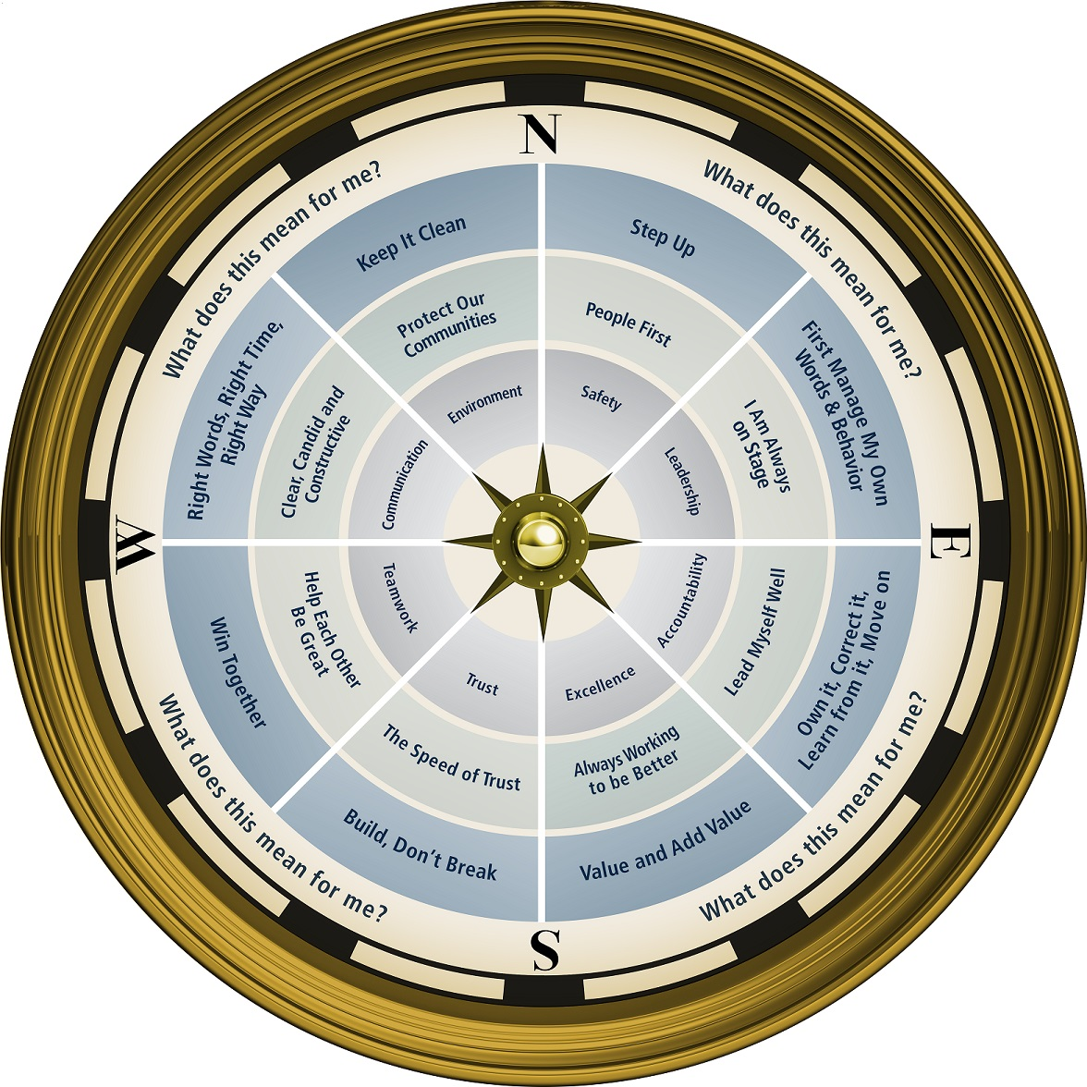


Slide 23
Opportunity Assignment
To Prepare for the Next Session:
Assignment:
1. The Leader’s Code
Chapter 5 The Connection
2. Leadership Development Plan
What will I do when I make a mistake?
3. Today’s Story
What is a life or leadership lesson?
Notes:
23

Slide 24

The Respectable Fish
What is a life or leadership lesson?
Notes:
24

Slide 25
This presentation is the intellectual property of Ken Chapman & Associates, Inc. It may not be modified or distributed in any format without expressed written permission from
Ken Chapman & Associates, Inc.
Copyright 2024. All rights reserved.

