Slide 1

This presentation is the intellectual property of Ken Chapman & Associates, Inc. It may not be modified or distributed in any format without expressed written permission from
Ken Chapman & Associates, Inc.
Copyright 2024. All rights reserved.

Slide 2
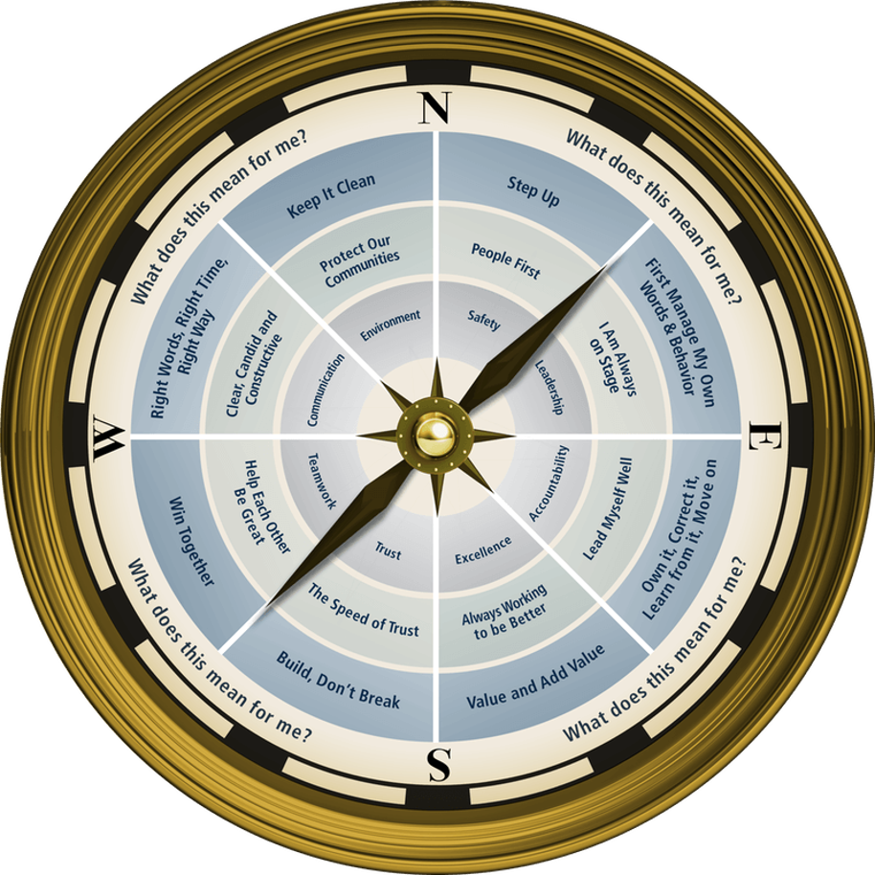

Session Three: Excellence
Ken Chapman and Associates, Inc. All Rights Reserved
Not Licensed for Use Outside McWane, Inc.

Slide 3

MUSIC TRIVIA
Ken Chapman & Associates, Inc. All Rights Reserved
Not Licensed for Use Outside McWane, Inc.

Slide 4
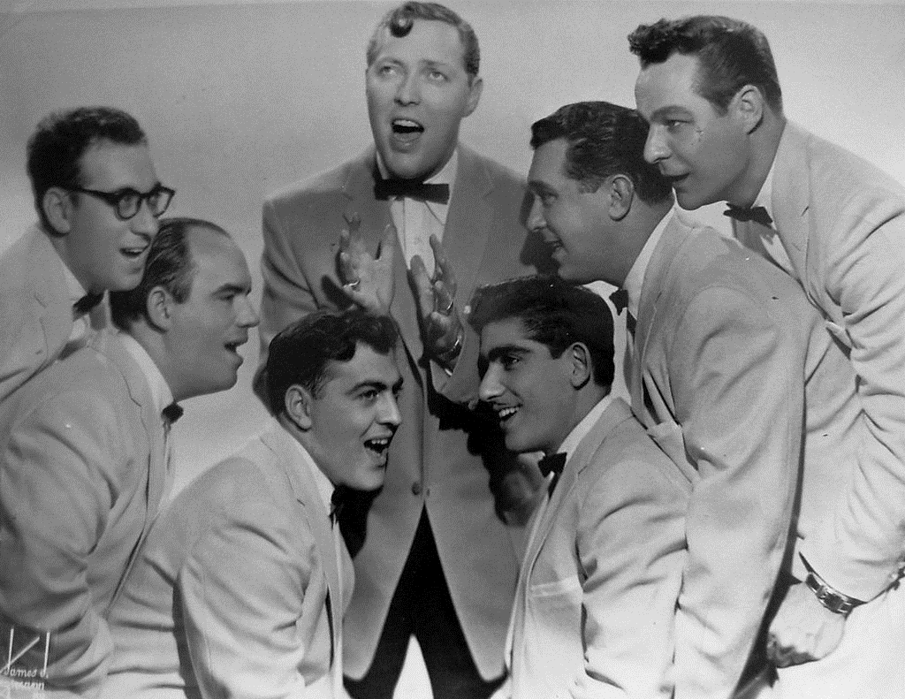
What was the first rock & roll song to hit
number 1 on the charts?
Heartbreak Hotel (Elvis Presley)
Tutti Frutti (Little Richard)
I Want to Hold Your Hand (The Beatles)
Rock Around the Clock (Bill Haley & the Comets)
It hit #1 July 9, 1955. It was later used as the theme song for Happy Days.
Ken Chapman & Associates, Inc. All Rights Reserved
Not Licensed for Use Outside McWane, Inc.

Slide 5
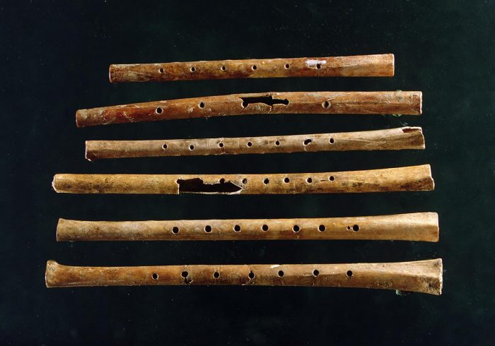
What is the oldest surviving musical instrument?
drum
lyre
flute
trumpet
A flute made from a hollow bone was found in Slovenia in 1989 and is estimated to be at least 43,000 years old.
Ken Chapman & Associates, Inc. All Rights Reserved
Not Licensed for Use Outside McWane, Inc.

Slide 6
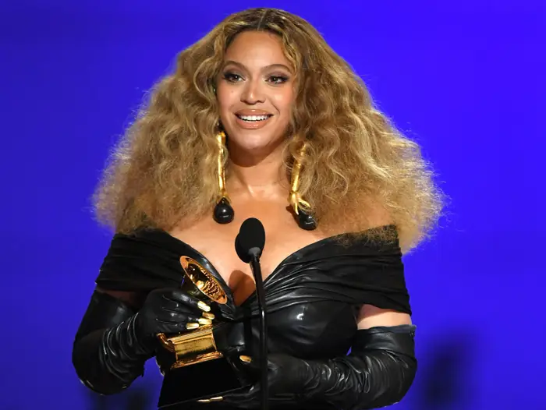
What female artist has won the most Grammy Awards?
Madonna
Alison Krauss
Dolly Parton
Beyoncé
Ken Chapman & Associates, Inc. All Rights Reserved
Not Licensed for Use Outside McWane, Inc.

Slide 7
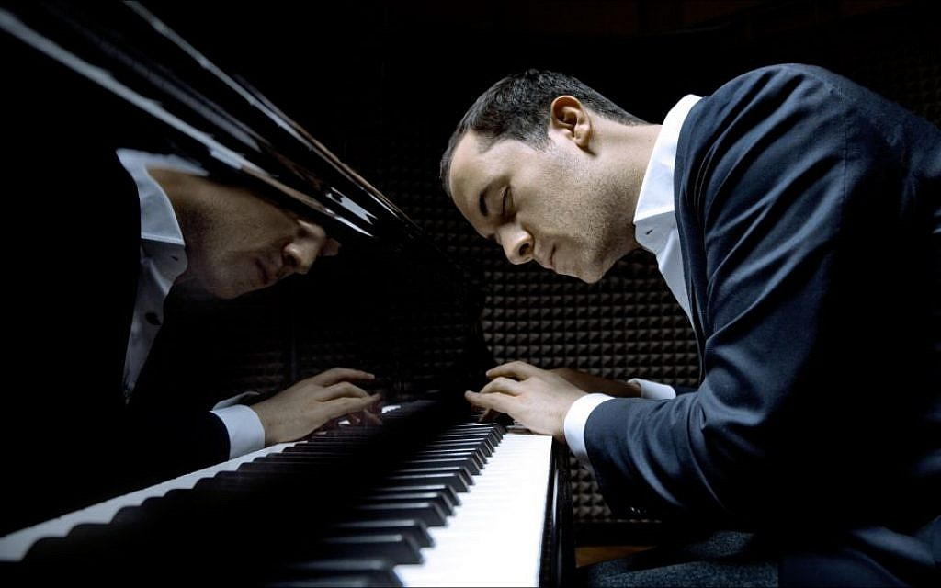
How many keys does a piano have?
88
70
65
96
It has 7 octaves made up of 52 white keys
and 36 black keys.
Ken Chapman & Associates, Inc. All Rights Reserved
Not Licensed for Use Outside McWane, Inc.

Slide 8
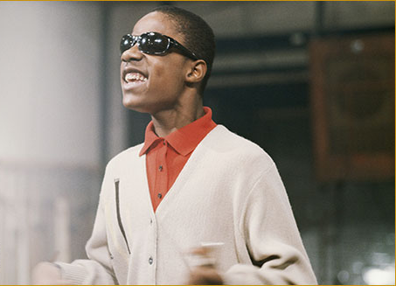
Who holds the record for being the youngest solo artist to score a #1 hit on the Billboard charts?
Stevie Wonder
Britney Spears
Michael Jackson
LeAnn Rimes
He was only 13. Michael Jackson recorded successfully with the Jackson 5, but didn’t release any solo albums until he was in his 20s.
Ken Chapman & Associates, Inc. All Rights Reserved
Not Licensed for Use Outside McWane, Inc.

Slide 9
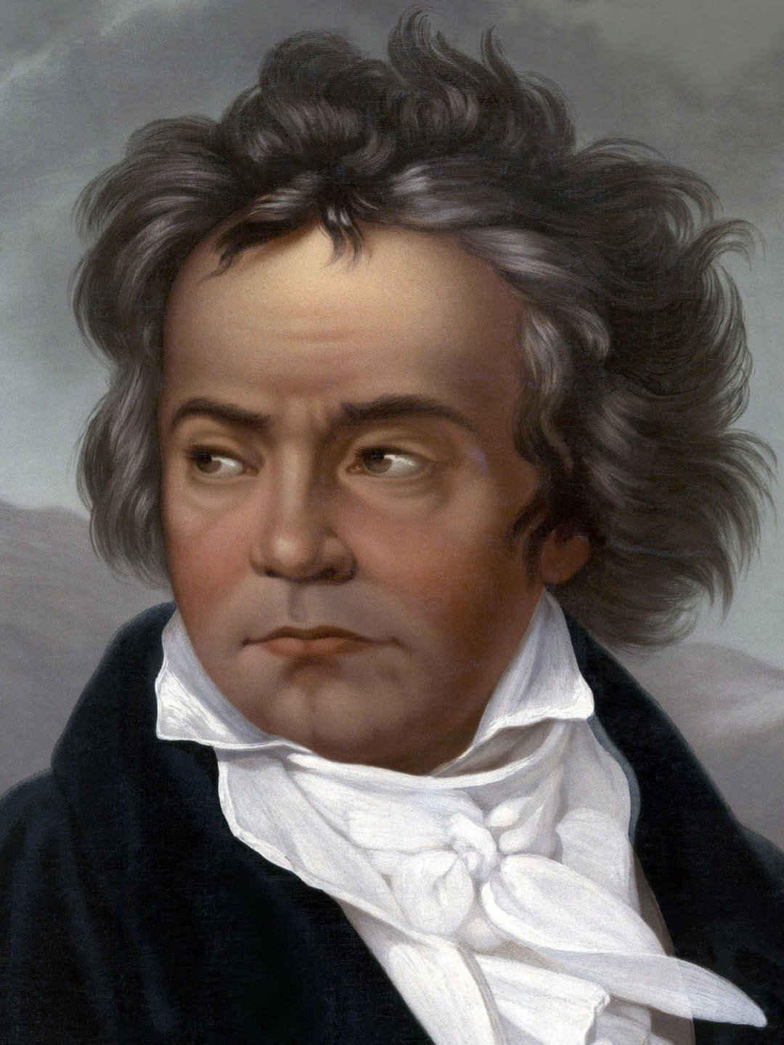
Which classical composer was deaf?
Bach
Mozart
Chopin
Beethoven
He reportedly began having hearing problems at the age of 26 and was completely deaf by the age of 46.
Ken Chapman & Associates, Inc. All Rights Reserved
Not Licensed for Use Outside McWane, Inc.

Slide 10
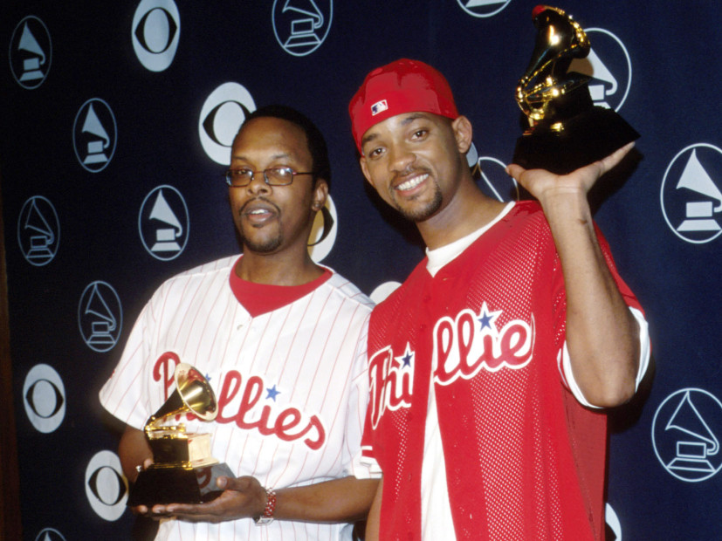
The category “Best Rap Performance” was added to the Grammys in 1989. Who won?
Salt-N-Pepa
DJ Jazzy Jeff and the Fresh Prince
LL Cool J
Young MC
The song was
“Parents Just Don’t Understand.”
Ken Chapman & Associates, Inc. All Rights Reserved
Not Licensed for Use Outside McWane, Inc.

Slide 11
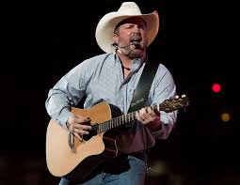
Who is the best-selling country
music artist of all time?
George Strait
Shania Twain
Garth Brooks
Kenny Rogers
Among all performers across genres, he’s second only to The Beatles.
Ken Chapman & Associates, Inc. All Rights Reserved
Not Licensed for Use Outside McWane, Inc.

Slide 12


Session Standards
Confirmed in Session One
Silence cell phones.
No “active” email & texting.
If it’s necessary to take a call or return a message, please leave the room. Step away so that your conversation does not interrupt the team discussion.
Refrain from side conversations.
Personal stories or examples shared by team members remain in this room.
Ken Chapman & Associates, Inc. All Rights Reserved
Not Licensed for Use Outside McWane, Inc.

Slide 13
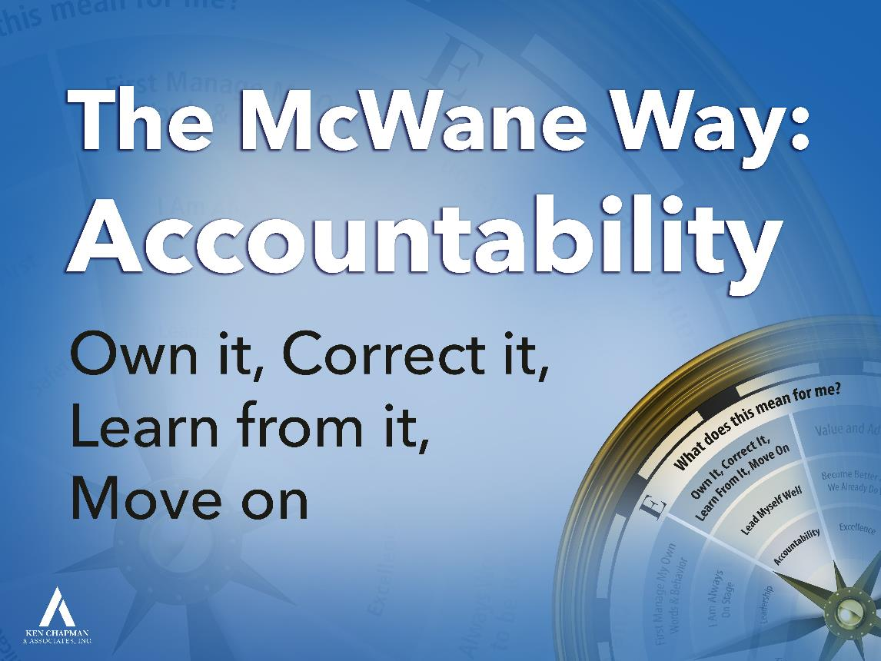

Leadership Development Plan:
Own It, Correct It, Learn From It, and Qualify to Move On
You were asked to set a goal from Session Two focused on “What will I do when I make a mistake?”
Please briefly share your goal and how it is going.
Ken Chapman & Associates, Inc. All Rights Reserved
Not Licensed for Use Outside McWane, Inc.
Notes:
Briefly review the Accountability Compass Point:
Nobody’s perfect. We all make mistakes. The only difference is, will you be the stand-up guy or gal who admits when you’ve made a mistake.
Will you own your mistake, correct it as best you can, prove you’ve learned from it (ASK: how can we prove we’ve learned from a mistake? …Don’t do it again), and then you can qualify to move on.
Lead Team member(s) will share an LDP example.
“Did everyone bring their gray card?” Ask them to hold up the card and if anyone needs a card.
Give them one minute on the clock to finalize their plan.
OK to ask for a volunteer to begin. Once someone volunteers, stay at that table until everyone has shared.
Applaud after last person shares.
13

Slide 14
Team Discussion
Opportunity Assignment Roundtable
The Leader’s Code
You were asked to read Chapter 5, The Connection.
Working in your teams, discuss the quote assigned
to your team.
What does this mean for you and your team?
Record your thoughts on paper.
Appoint a spokesperson for your team.
Ken Chapman & Associates, Inc. All Rights Reserved
Not Licensed for Use Outside McWane, Inc.
Notes:
Every time we get together, we’ll share a story at the end of the session. You’re asked to think about a life lesson or leadership lesson you can take away from the story. There’s always more than one lesson to be learned. I’m going to recap the story from Session 1. As I tell the story, think about something from the story you can apply to your life or leadership journey.
Once upon a time, there was a wise man who lived in a small village. Even though he did not think of himself as a wise man, his neighbors considered him a wise man because when they went to him for advice, he gave them very good advice.
Living in this same village was a young man who was rather sure the wise man was not so wise at all. Not only did he think the wise man was not wise, but he felt it was his responsibility to show everyone just how foolish the old man really was.
The young man thought about the old man for a few days and hatched a plan. “I’ll go to the wise man,” the young man said to himself, “when he’s giving advice in the public square. I’ll hold a bird cupped between my hands and ask him, ‘Oh wise one, tell me, is the bird I hold between my hands dead or alive?’ If he says the bird is alive, I’ll crush it and show him a dead bird. If, on the other hand, he says the bird is dead, I’ll open my hands and let the bird fly away. No matter how the old man responds, he’ll be wrong and everyone will see just how foolish the old guy really is.”
True to his plan, the young man waited until a Saturday afternoon when the wise man was in the public square giving advice. Just at the moment when the young man was satisfied the crowd had peaked, he approached the wise man. “Oh wise one, is the bird I hold between my hands dead or alive?”
The wise man looked the young man over carefully and considered the question. After a moment of silence, the wise man positioned himself so he could look the young man level in the eye. Then, placing his hand atop the cupped hands of the young man, the wise man responded to the question – Is the bird dead or alive?
“It is up to you,” said the wise man. “It is your choice!”
3 min., paper, appoint a spokesperson – There’s more than one lesson to be learned. We want to hear what your team took away from the story.
14

Slide 15
The Leader’s Code
The Connection
Quote #1
Dodge’s smokejumpers were a loosely associated crew – team cohesion did not exist. Cohesion requires people to know each other and to connect with each other. The connection gives team members a reason to have each other’s back.
[Chapter 5, Page 49]
Ken Chapman & Associates, Inc. All Rights Reserved
Not Licensed for Use Outside McWane, Inc.
Notes:
15
What’s it like to work with team members you can’t count on to have your back?

Slide 16
The Leader’s Code
The Connection
Quote #2
The Speed of Trust never had the chance to develop between Wagner Dodge and the team. The result is best expressed in the response of a team member when Dodge offered an impromptu strategy for saving their lives: “The hell with that. I’m getting out of here.”
[Chapter 5, Page 49]
Ken Chapman & Associates, Inc. All Rights Reserved
Not Licensed for Use Outside McWane, Inc.
Notes:
16
When you’re frightened, how likely are you to follow someone else’s suggestions? Does it make a difference if you trust that person and their ability?

Slide 17
The Leader’s Code
The Connection
Quote #3
Human connection is the first mile marker on the road to trust. It begins when leaders get to know others and allow others to get to know them. The bottom line: the more connected people feel, the better they behave.
[Chapter 5, Page 49]
Ken Chapman & Associates, Inc. All Rights Reserved
Not Licensed for Use Outside McWane, Inc.
Notes:
17
How willing are you to share your knowledge and experience with someone who doesn’t value you?
How willing are you to share your knowledge and experience with someone who hasn’t made an effort to connect with you?

Slide 18
The Leader’s Code
The Connection
Quote #4
In the case of Wagner Dodge, he contributed knowledge, experience, courage, and determination. He was more than willing to assert the value of what he brought to the table that day. So much so, that he completely discounted his team members’ knowledge and experience. Even more, he did not place a value on the human connection.
[Chapter 5, Page 50]
Ken Chapman & Associates, Inc. All Rights Reserved
Not Licensed for Use Outside McWane, Inc.
Notes:
18
What might Dodge have done to make a connection with the other smokejumpers?

Slide 19
The Leader’s Code
The Connection
Quote #5
People don’t care what you know until they know you care. Team members will often do for a leader they respect that they would never do for the merely competent leader. The bottom line: People want to be valued far more than they want to be impressed.
[Chapter 5, Page 52]
Ken Chapman & Associates, Inc. All Rights Reserved
Not Licensed for Use Outside McWane, Inc.
Notes:
19
What’s it like to work for someone who is competent, but doesn’t respect others?
How likely are you to work hard for someone who is competent, but doesn’t seem to value or respect you?

Slide 20
The Leader’s Code
The Connection
Quote #6
Wagner Dodge was a good, well-intentioned man. He was fearless, experienced, and competent. Unfortunately, he believed that competence was the most important quality a leader could possess. His competence became his greatest liability.
[Chapter 5, Page 55]
Ken Chapman & Associates, Inc. All Rights Reserved
Not Licensed for Use Outside McWane, Inc.
Notes:
20
Is being competent enough?
If someone believes competence is all that matters, will he or she make an effort to connect with you?

Slide 21

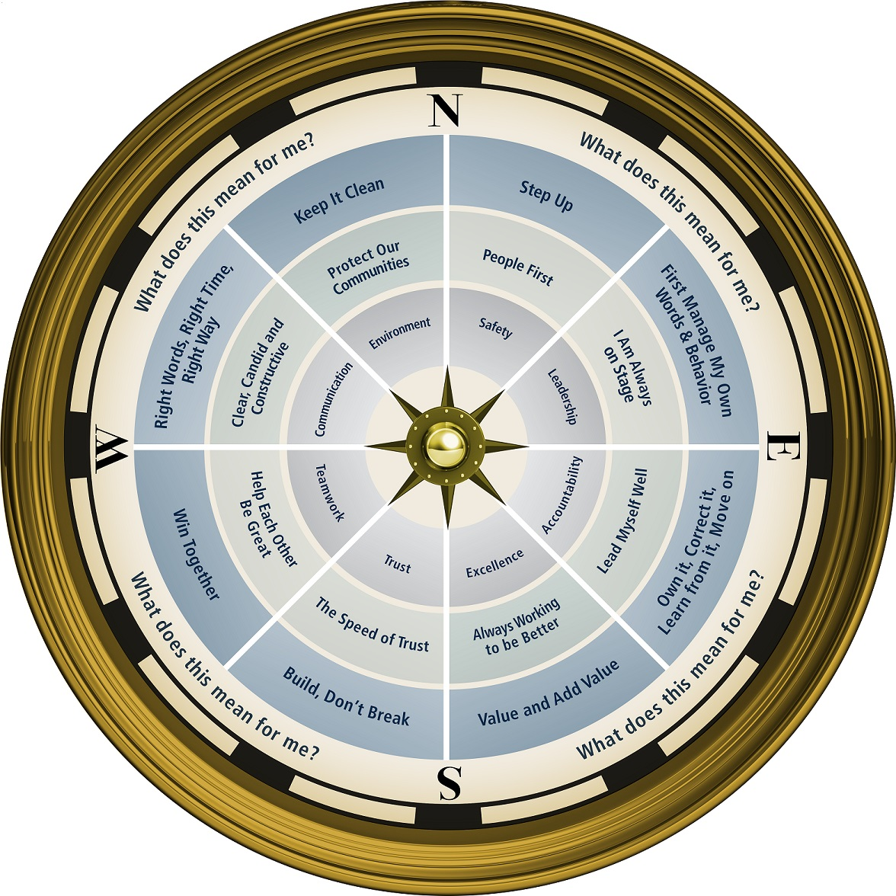

Ken Chapman & Associates, Inc. All Rights Reserved
Not Licensed for Use Outside McWane, Inc.
Notes:
The Compass appears here as a placeholder. This is an appropriate point for a 7 minute break.

Slide 22
Opportunity Assignment
To Prepare for the Next Session:
Assignment:
1. The Leader’s Code
Chapter 4 The Speed of Trust
2. Leadership Development Plan
What can I do to respectfully disagree?
3. Today’s Story
What is a life or leadership lesson?
Ken Chapman & Associates, Inc. All Rights Reserved
Not Licensed for Use Outside McWane, Inc.
Notes:
Encourage Team Members to write the information in their notebooks. (Some depend on supervisors to keep up with the dates, and this can cause frustration for all involved).
Hand out grey cards.
They need to complete the LDP ahead of the next session.
Ask if there are any questions before the story.
22

Slide 23
This presentation is the intellectual property of Ken Chapman & Associates, Inc. It may not be modified or distributed in any format without expressed written permission from
Ken Chapman & Associates, Inc.
Copyright 2024. All rights reserved.

