Slide 1

This presentation is the intellectual property of Ken Chapman & Associates, Inc. It may not be modified or distributed in any format without expressed written permission from
Ken Chapman & Associates, Inc.
Copyright 2024. All rights reserved.

Slide 2
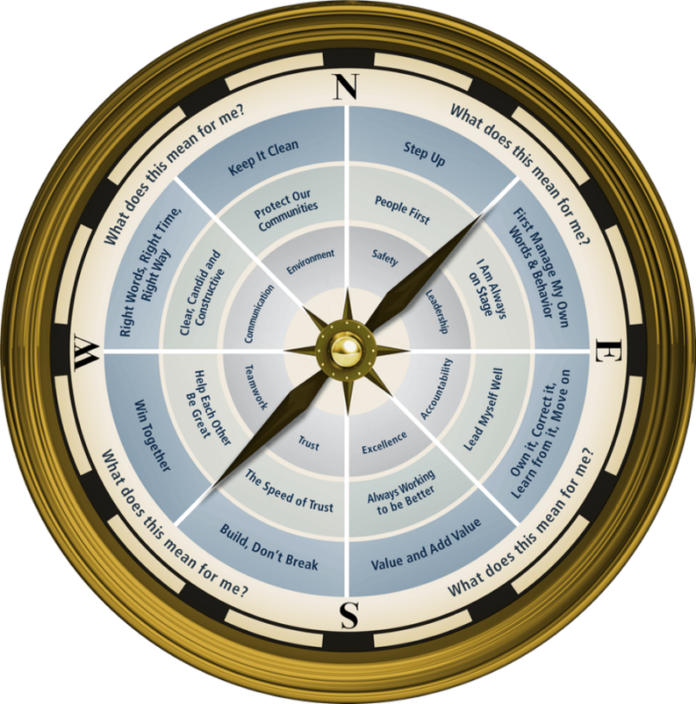
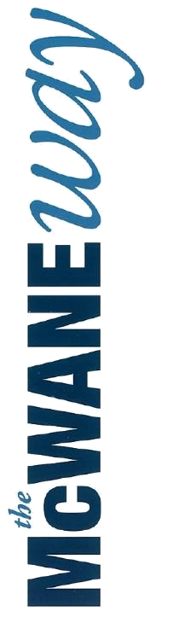
Session Four: Trust
Ken Chapman and Associates, Inc. All Rights Reserved
Not Licensed for Use Outside McWane, Inc.

Slide 3
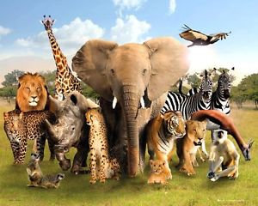
ANIMAL TRIVIA
Ken Chapman & Associates, Inc. All Rights Reserved
Not Licensed for Use Outside McWane, Inc.

Slide 4
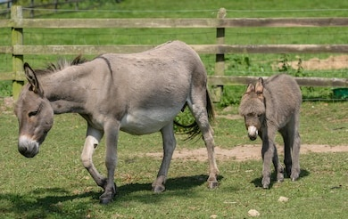
What is a female donkey called?
a Mule
a Jane
a Mare
a Jenny
A male donkey is called a Jack.
Ken Chapman & Associates, Inc. All Rights Reserved
Not Licensed for Use Outside McWane, Inc.

Slide 5
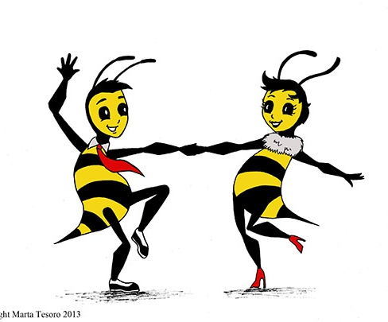
How do honey bees communicate
with each other?
flapping their wings
buzzing
dancing
reading each other’s minds
A worker bee performs a “waggle dance” to communicate that she’s found a good source of pollen. The longer she dances, the farther away from the nest the flower patch.
Ken Chapman & Associates, Inc. All Rights Reserved
Not Licensed for Use Outside McWane, Inc.

Slide 6
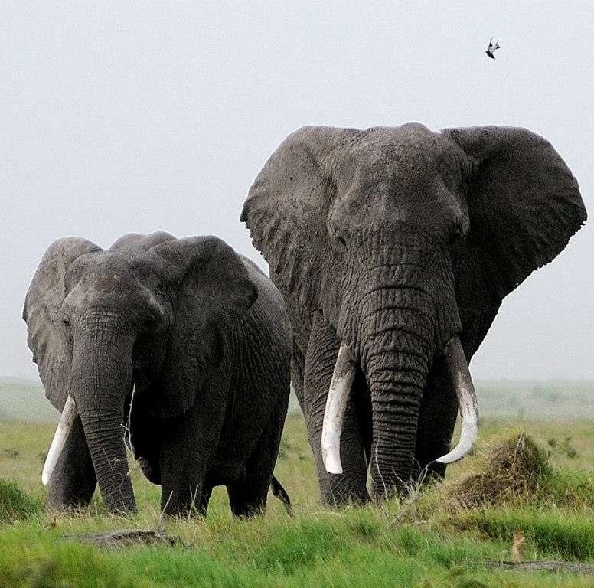
Other than humans, what land mammal typically lives the longest?
giraffe
elephant
gorilla
polar bear
The African elephant has an average lifespan of 70 years!
Ken Chapman & Associates, Inc. All Rights Reserved
Not Licensed for Use Outside McWane, Inc.

Slide 7
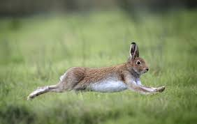
Which of the following mammals
is the fastest?
hare
horse
greyhound
deer
The brown hare can reach speeds of up to
47 miles per hour.
Ken Chapman & Associates, Inc. All Rights Reserved
Not Licensed for Use Outside McWane, Inc.

Slide 8
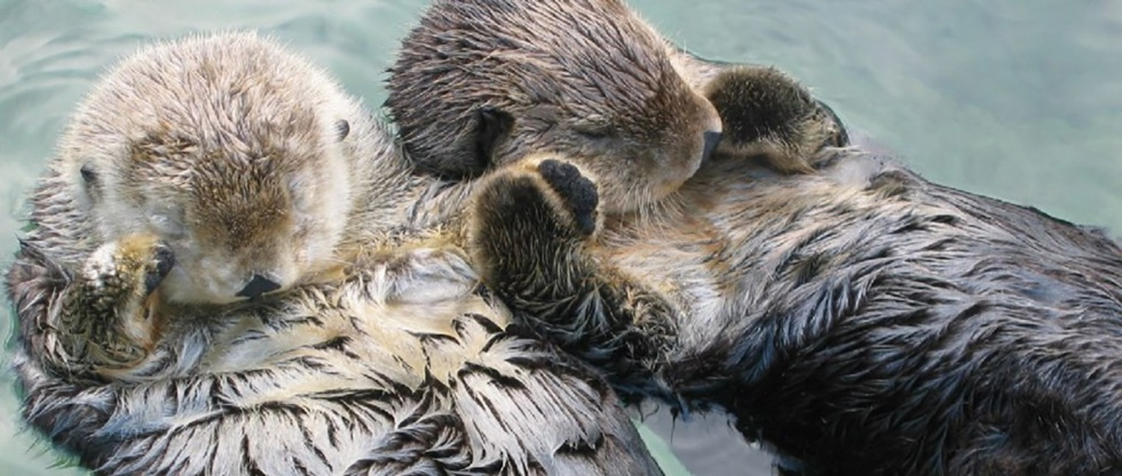
What mammals “hold hands”
while sleeping?
otters
tigers
monkeys
sloths
Otters sleep while floating in the water, so they hold hands to keep from getting separated.
Ken Chapman & Associates, Inc. All Rights Reserved
Not Licensed for Use Outside McWane, Inc.

Slide 9
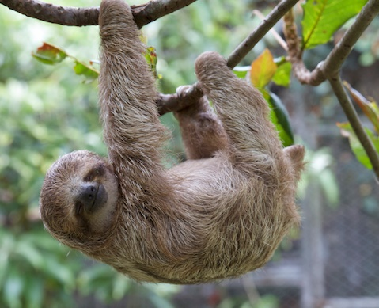
Which of the following land animals
is the slowest?
tortoise
sloth
elephant
panda
Three-toed sloths move at a rate of about
15 feet an hour.
Ken Chapman & Associates, Inc. All Rights Reserved
Not Licensed for Use Outside McWane, Inc.

Slide 10
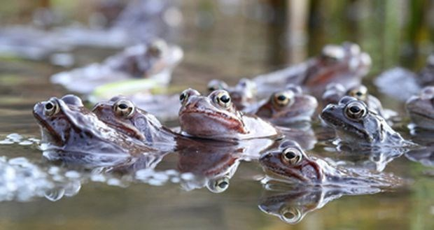
What is a group of frogs called?
a herd
a pod
an army
a crowd
A group of toads is called a knot.
Ken Chapman & Associates, Inc. All Rights Reserved
Not Licensed for Use Outside McWane, Inc.

Slide 11


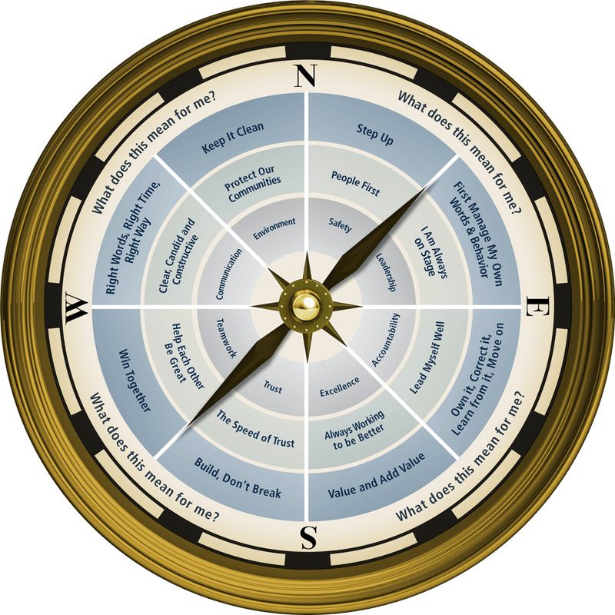
Session Standards
Confirmed in Session One
Silence cell phones.
No “active” email & texting.
If it’s necessary to take a call or return a message, please leave the room. Step away so that your conversation does not interrupt the team discussion.
Refrain from side conversations.
Personal stories or examples shared by team members remain in this room.
Ken Chapman & Associates, Inc. All Rights Reserved
Not Licensed for Use Outside McWane, Inc.

Slide 12
Opportunity Assignment Roundtable:
The Leader’s Code
Pause for Team Discussion
You were asked to read Chapter 4, The Speed of Trust.
Working in your teams, discuss the quote your team has been assigned.
What does this mean for you and your team?
Record your thoughts on paper.
Appoint a spokesperson for your team.
Ken Chapman & Associates, Inc. All Rights Reserved
Not Licensed for Use Outside McWane, Inc.

Slide 13
The Leader’s Code
The Speed of Trust
Quote #1
When people do not trust each other, they do not get involved. They comply. They keep their heads down. They do what they have to do. It takes all their energy to make their way around the potholes (the gotchas) of the culture. People focus on surviving, not thriving.
[Chapter 4, Page 33]
Ken Chapman & Associates, Inc. All Rights Reserved
Not Licensed for Use Outside McWane, Inc.
Notes:
What kind of “gotchas” have you had to work around?
What happens if everyone on the team is trying to keep their heads down?
13

Slide 14
The Leader’s Code
The Speed of Trust
Quote #2
People trust accountability. This means I must assume full responsibility for being trustworthy. My first responsibility is to manage my own words and behavior. It only works if I am fully responsible for me – no complaints, no hedging, no excuses.
[Chapter 4, Page 34]
Ken Chapman & Associates, Inc. All Rights Reserved
Not Licensed for Use Outside McWane, Inc.
Notes:
Why do people trust someone who is willing to accept responsibility for themselves?
14

Slide 15
The Leader’s Code
The Speed of Trust
Quote #3
People trust candor and clarity.
They may not always like it, but they trust it.
[Chapter 4, Page 35]
Ken Chapman & Associates, Inc. All Rights Reserved
Not Licensed for Use Outside McWane, Inc.
Notes:
Would you rather have someone tell you the truth even though you may not want to hear it or have someone tell you a lie just because it sounds good? (ugly truth vs. pretty lie?)
15

Slide 16
The Leader’s Code
The Speed of Trust
Quote #4
People trust those who make the effort to care and connect. People do not care what you know until they know you care. We do not, and often cannot, trust what we do not know. The people around us need to know who we are, where we are from, and what is important to us. We must listen long enough and well enough to learn the same about them.
[Chapter 4, Pages 36-37]
Ken Chapman & Associates, Inc. All Rights Reserved
Not Licensed for Use Outside McWane, Inc.
Notes:
16
Do you trust a stranger you’ve just met in an airport or in the grocery store?
Do you have to know everything about a person in order to be able to trust them?

Slide 17
The Leader’s Code
The Speed of Trust
Quote #5
People trust clear-eyed optimism. Optimism inspires trust. People want to believe things will work out. No matter how gloomy the present circumstance, people are drawn to hope. They know a can-do attitude makes a big difference.
[Chapter 4, Page 39]
Ken Chapman & Associates, Inc. All Rights Reserved
Not Licensed for Use Outside McWane, Inc.
Notes:
17
Are you more likely to trust an optimist or a pessimist? Why?
What do we mean by “clear-eyed” optimist? (Be realistic in your optimism.) Why is this important?

Slide 18
The Leader’s Code
The Speed of Trust
Quote #6
People are drawn to the confident but humble leader. They find it easy to trust humility and easy to trust the humbly confident leader. They trust the leader who, while confident, avoids arrogance. Arrogance is a trust buster. Perfection is not believable. No one knows everything. No one is 100 percent right 100 percent of the time. Even at their best, people remain imperfect.
[Chapter 4, Page 41]
Ken Chapman & Associates, Inc. All Rights Reserved
Not Licensed for Use Outside McWane, Inc.
Notes:
18
What makes it hard to trust someone who claims to know everything?

Slide 19
The Leader’s Code
The Speed of Trust
Quote #7
They love that Ralph trusts them and the customers are quick to return the compliment. I once observed a man place an order, receive his order, and then attempt to walk away. Four of Ralph’s customers blocked the man. They did not get physical with him. They simply stood in his exit path and pointed to the cash box. And, as if reciting a chant they had practiced said, “You need to pay before you leave.”
[Chapter 4, Pages 42-43]
Ken Chapman & Associates, Inc. All Rights Reserved
Not Licensed for Use Outside McWane, Inc.
Notes:
19
Why were Ralph’s customers enforcing his honor code?
Can you think of an example from your own experience where someone has trusted you to pay?

Slide 20
Pause for Team Discussion
The Speed of Trust
Working in your teams, develop a T-Chart of
Trust Builders and Trust Busters.
Assign a team member to report for your team.
Trust Builders Trust Busters
Ken Chapman & Associates, Inc. All Rights Reserved
Not Licensed for Use Outside McWane, Inc.

Slide 21
Top Trust Builders
Rate your own performance, by category, as of today.
1 2 3 4 5
Poor Excellent
1. _____________________
1 2 3 4 5
Poor Excellent
2. _____________________
1 2 3 4 5
Poor Excellent
3. _____________________
1 2 3 4 5
Poor Excellent
4. _____________________
1 2 3 4 5
Poor Excellent
5. _____________________
1 2 3 4 5
Poor Excellent
6. _____________________
Ken Chapman & Associates, Inc. All Rights Reserved
Not Licensed for Use Outside McWane, Inc.

Slide 22
Opportunity Assignment
To Prepare for the Next Session:
Assignment:
1. The Leader’s Code
Chapter 14 The Elephant in the Room
2. Leadership Development Plan
Choose a Trust Builder; How can I show my
team I can be trusted?
3. Today’s Story
What is a life or leadership lesson?
Ken Chapman & Associates, Inc. All Rights Reserved
Not Licensed for Use Outside McWane, Inc.
Notes:
22

Slide 23
This presentation is the intellectual property of Ken Chapman & Associates, Inc. It may not be modified or distributed in any format without expressed written permission from
Ken Chapman & Associates, Inc.
Copyright 2024. All rights reserved.

