Slide 1

This presentation is the intellectual property of Ken Chapman & Associates, Inc. It may not be modified or distributed in any format without expressed written permission from
Ken Chapman & Associates, Inc.
Copyright 2024. All rights reserved.

Slide 2
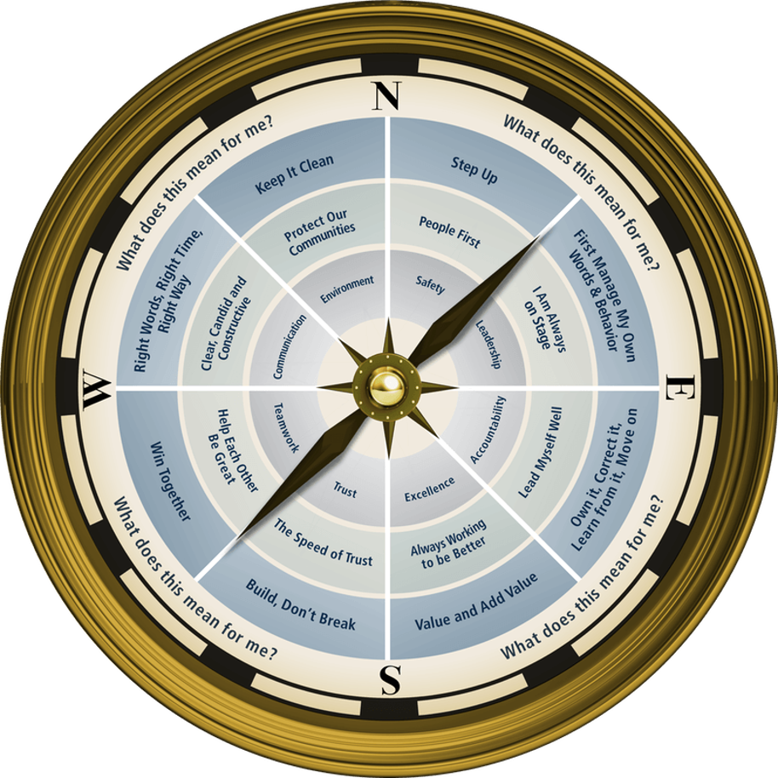

Session Five: Teamwork
Ken Chapman and Associates, Inc. All Rights Reserved
Not Licensed for Use Outside McWane, Inc.

Slide 3


Boys of Summer
Put me in, Coach!

Slide 4
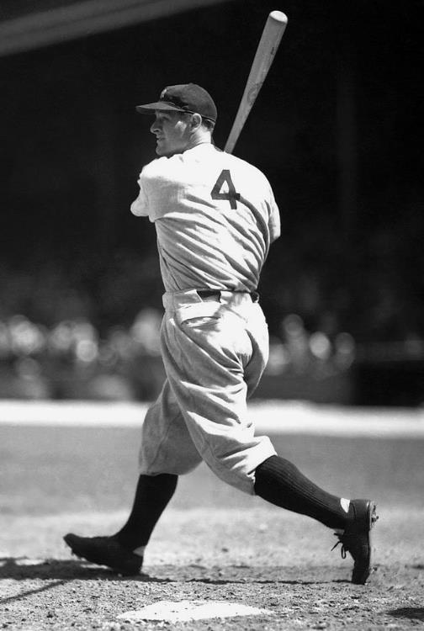
Who was the first Major League player to have his number retired?
Ty Cobb
Lou Gehrig
Jackie Robinson
Babe Ruth

Slide 5
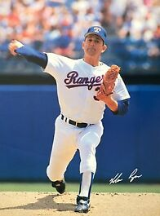
Which of these MLB pitchers never took home a Cy Young Award?
Catfish Hunter
John Smoltz
Don Drysdale
Nolan Ryan
Ryan holds the record for strikeouts (5,714) and no hitters (7), but never won the coveted award.

Slide 6
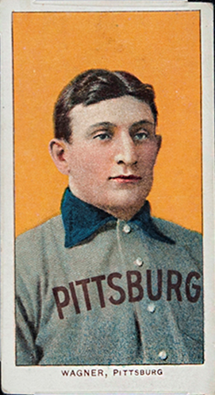
Whose baseball card sold for a record $3.12 million at auction in 2016?
Mickey Mantle
Ted Williams
Honus Wagner
Roberto Clemente
Issued by the American Tobacco Company in 1909. Only 50-200 made it into circulation.

Slide 7
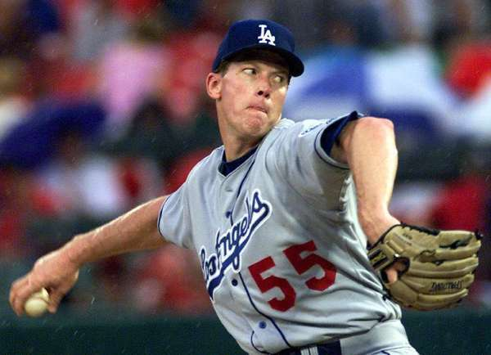
Who holds the MLB record of 59 consecutive scoreless innings pitched?
Orel Hershiser
Pedro Martinez
Greg Maddux
Steve Carlton
From the 6th inning on August 30, 1988 until the 10th inning on September 28.

Slide 8
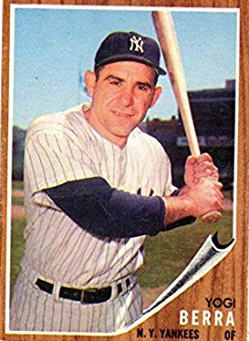
Which player appeared in the most
World Series games?
Yogi Berra
Mickey Mantle
Derek Jeter
Pee Wee Reese
Won 10 Series as a player and 3 as a manager.
75 total games.

Slide 9
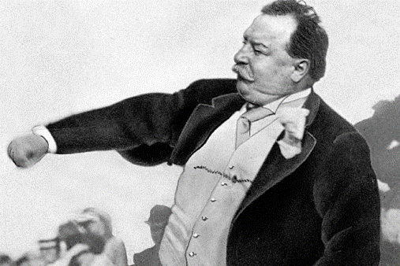
Who was the first U.S. President to throw out the season opening pitch?
Teddy Roosevelt
John F. Kennedy
William H. Taft
Dwight Eisenhower
Opened the season on April 14, 1910.

Slide 10

What year was the first World Series?
1890
1873
1903
1908
Boston Americans beat the Pittsburgh Pirates
5 games to 3 (9 game series until 1905).

Slide 11


Session Standards
Confirmed in Session One
Silence cell phones
No “active” email & texting
If it’s necessary to take a call or return a message, please leave the room. Step away so your conversation does not interrupt the team discussion.
Refrain from side conversations.
Personal stories or examples shared by team members remain in this room.
Notes:
“These are your session standards that you agreed upon on (DATE).”

Slide 12

Top Trust Builders
Rank your own performance, by category, as of today.
1 2 3 4 5
Poor Excellent
1. _____________________
1 2 3 4 5
Poor Excellent
2. _____________________
1 2 3 4 5
Poor Excellent
3. _____________________
1 2 3 4 5
Poor Excellent
4. _____________________
1 2 3 4 5
Poor Excellent
5. _____________________
1 2 3 4 5
Poor Excellent
6. _____________________
Notes:
If these are the characteristics you look for in someone else to decide if you can trust them, then you must exhibit these characteristics if you want others to trust you.
Hand out grey LDP cards and ask TMs to write the list as it appears on the flipchart paper.
Next, ask them to rank their performance based on the Top Trust Builders. “If you feel you’re really good at one of them, you might give yourself a 4-5. However, you may think you have some work to do on another, and you may feel you’re a 2-3.”
They do not have to turn them in or share them with those around them, but they will be used for their LDP.

Slide 13
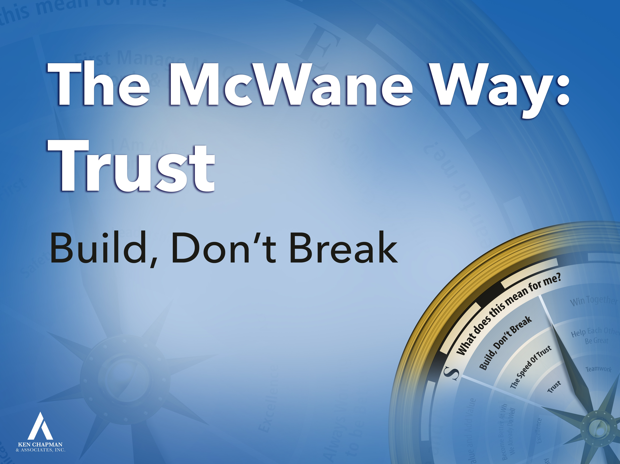
Leadership Development Plan:
Build, Don’t Break
You were asked to set a goal from Session Four focused on “How can I show my team I can be trusted?”
Please briefly share your goal and how it is going.
Notes:
For your LDP, you were asked to set a goal focused on “How can I show my team I can be trusted?” You may have wanted to think about one or more of your Trust Builders.
Before we present our goals, we have ___ to share theirs from when they went through the Leader’s Code process.
Lead Team member(s) will share an LDP example. (Make sure you’ve let them know to bring their LDP on Trust.)
Applaud for Lead Team member and thank them for coming.
Give Team Members one minute on the clock to finalize their plan.
OK to ask for a volunteer to begin. Once someone volunteers, stay at that table until everyone has shared.
13

Slide 14
Opportunity Assignment Roundtable:
The Leader’s Code
Pause for Team Discussion
You were asked to read Chapter 14, The Elephant in the Room.
Working in your teams, discuss the quote your team has been assigned.
What does this mean for you and your team?
Record your thoughts on paper.
Appoint a spokesperson for your team.
Notes:
4 min., paper
Prepare a few questions of your own from the chapter. Use them to focus the discussion as each team reports.
TM should come to front of the room to provide the team’s report. One TM should read the quote while the spokesperson makes their way to the front of the room.

Slide 15
The Leader’s Code
The Elephant in the Room
Quote #1
What was true for the six blind men is true for all potential teams. Potential teams are just another way of describing a workgroup before it becomes a team. Different perspectives are both the strength and potential weakness of a team. As with the six men in the story, all potential teams have a choice. Do we find a way to benefit from our differing knowledge and experiences? Or do we fail because we come from different backgrounds and experiences?
[Chapter 14, Page 153]
Notes:
How can differences or different viewpoints be a strength?
How can they turn into a weakness?

Slide 16
The Leader’s Code
The Elephant in the Room
Quote #2
All successful teams go through all four stages. Sometimes a team gets lucky. Its mix of personalities and its leadership brings the team from forming to performing with minimal struggle and in record time. But no team goes directly from forming to performing. Disagreeing, understanding, and learning to trust are necessary parts of team development.
[Chapter 14, Pages 153-154]
4 Stages of Team Development
Forming Storming Norming Performing
Notes:
What types of adjustments might there be with a new team or when a new team member joins an existing team?
FOUR STAGES OF TEAM DEVELOPMENT
Forming: team members are getting to know one another and figuring out how to deal with each other; not a team but a workgroup (a group of individuals assigned to work together)
Storming: team members are figuring out their individual roles in the team; trust is being built to work towards The Speed of Trust
Norming: team members have accepted their roles and are beginning to feel comfortable with each other; The Speed of Trust is established
Performing: working as a team, high levels of production and quality are achieved, team is moving towards excellence

Slide 17
The Leader’s Code
The Elephant in the Room
Quote #3
Storming team members often try to encourage each other to follow one specific rule: you can say anything. This is both true and untrue. Each person must feel free to speak. However, sniping, blaming, and belittling remarks are poison, not only to the person being targeted, but also to the sense of trust necessary for the team to function.
[Chapter 14, Page 157]
4 Stages of Team Development
Forming Storming Norming Performing
Notes:
How could not feeling free (safe) to speak keep a team from developing?
How can “sniping, blaming, and belittling” remarks keep a team from developing?

Slide 18
The Leader’s Code
The Elephant in the Room
Quote #4
The best reward a leader can provide is the certainty the team will not be expected to work with the outlier indefinitely.
[Chapter 14, Page 158]
Notes:
What does it do to a team when you have a team member who doesn’t “pull their weight”?
Does it make a difference if your supervisor or leadman deals with it?

Slide 19
The Leader’s Code
The Elephant in the Room
Quote #5
Performing is defined by accountability, pride of association and workmanship, cohesion, and results! Every member of the team recognizes they cannot do the job alone. Each team member values what the other team members bring to the table. Individual success is celebrated, but team success is celebrated more.
[Chapter 14, Page 159]
4 Stages of Team Development
Forming Storming Norming Performing
Notes:
Would you want to work on a team like this? Why?

Slide 20
The Leader’s Code
The Elephant in the Room
Quote #6
Developing the Speed of Trust requires each stage. Keep your focus on the destination: A high-performance team where everything takes less time, costs less, and produces ever-higher morale.
[Chapter 14, Page 162]
4 Stages of Team Development
Forming Storming Norming Performing
Notes:
Who benefits if everything takes less time and costs less?
Does working on a team where you trust one another really improve morale? How?
FOUR STAGES OF TEAM DEVELOPMENT
Forming: team members are getting to know one another and figuring out how to deal with each other; not a team but a workgroup (a group of individuals assigned to work together)
Storming: team members are figuring out their individual roles in the team; trust is being built to work towards The Speed of Trust
Norming: team members have accepted their roles and are beginning to feel comfortable with each other; The Speed of Trust is established
Performing: working as a team, high levels of production and quality are achieved, team is moving towards excellence

Slide 21

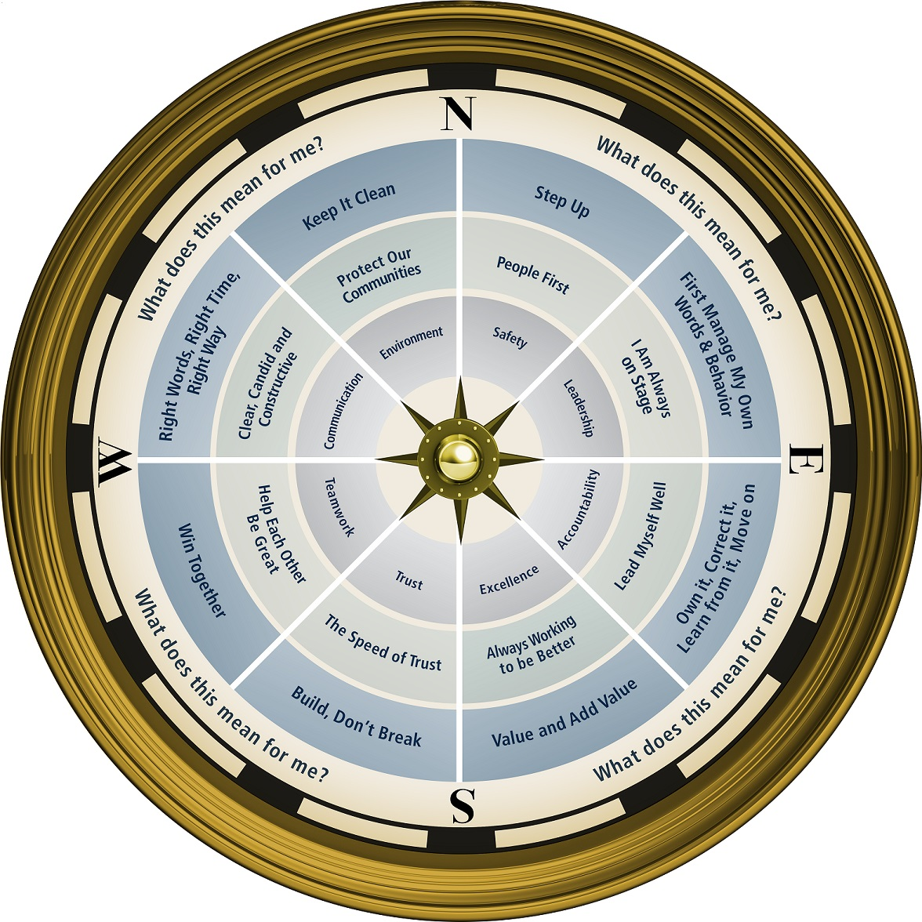

Notes:
7 MINUTE BREAK

Slide 22
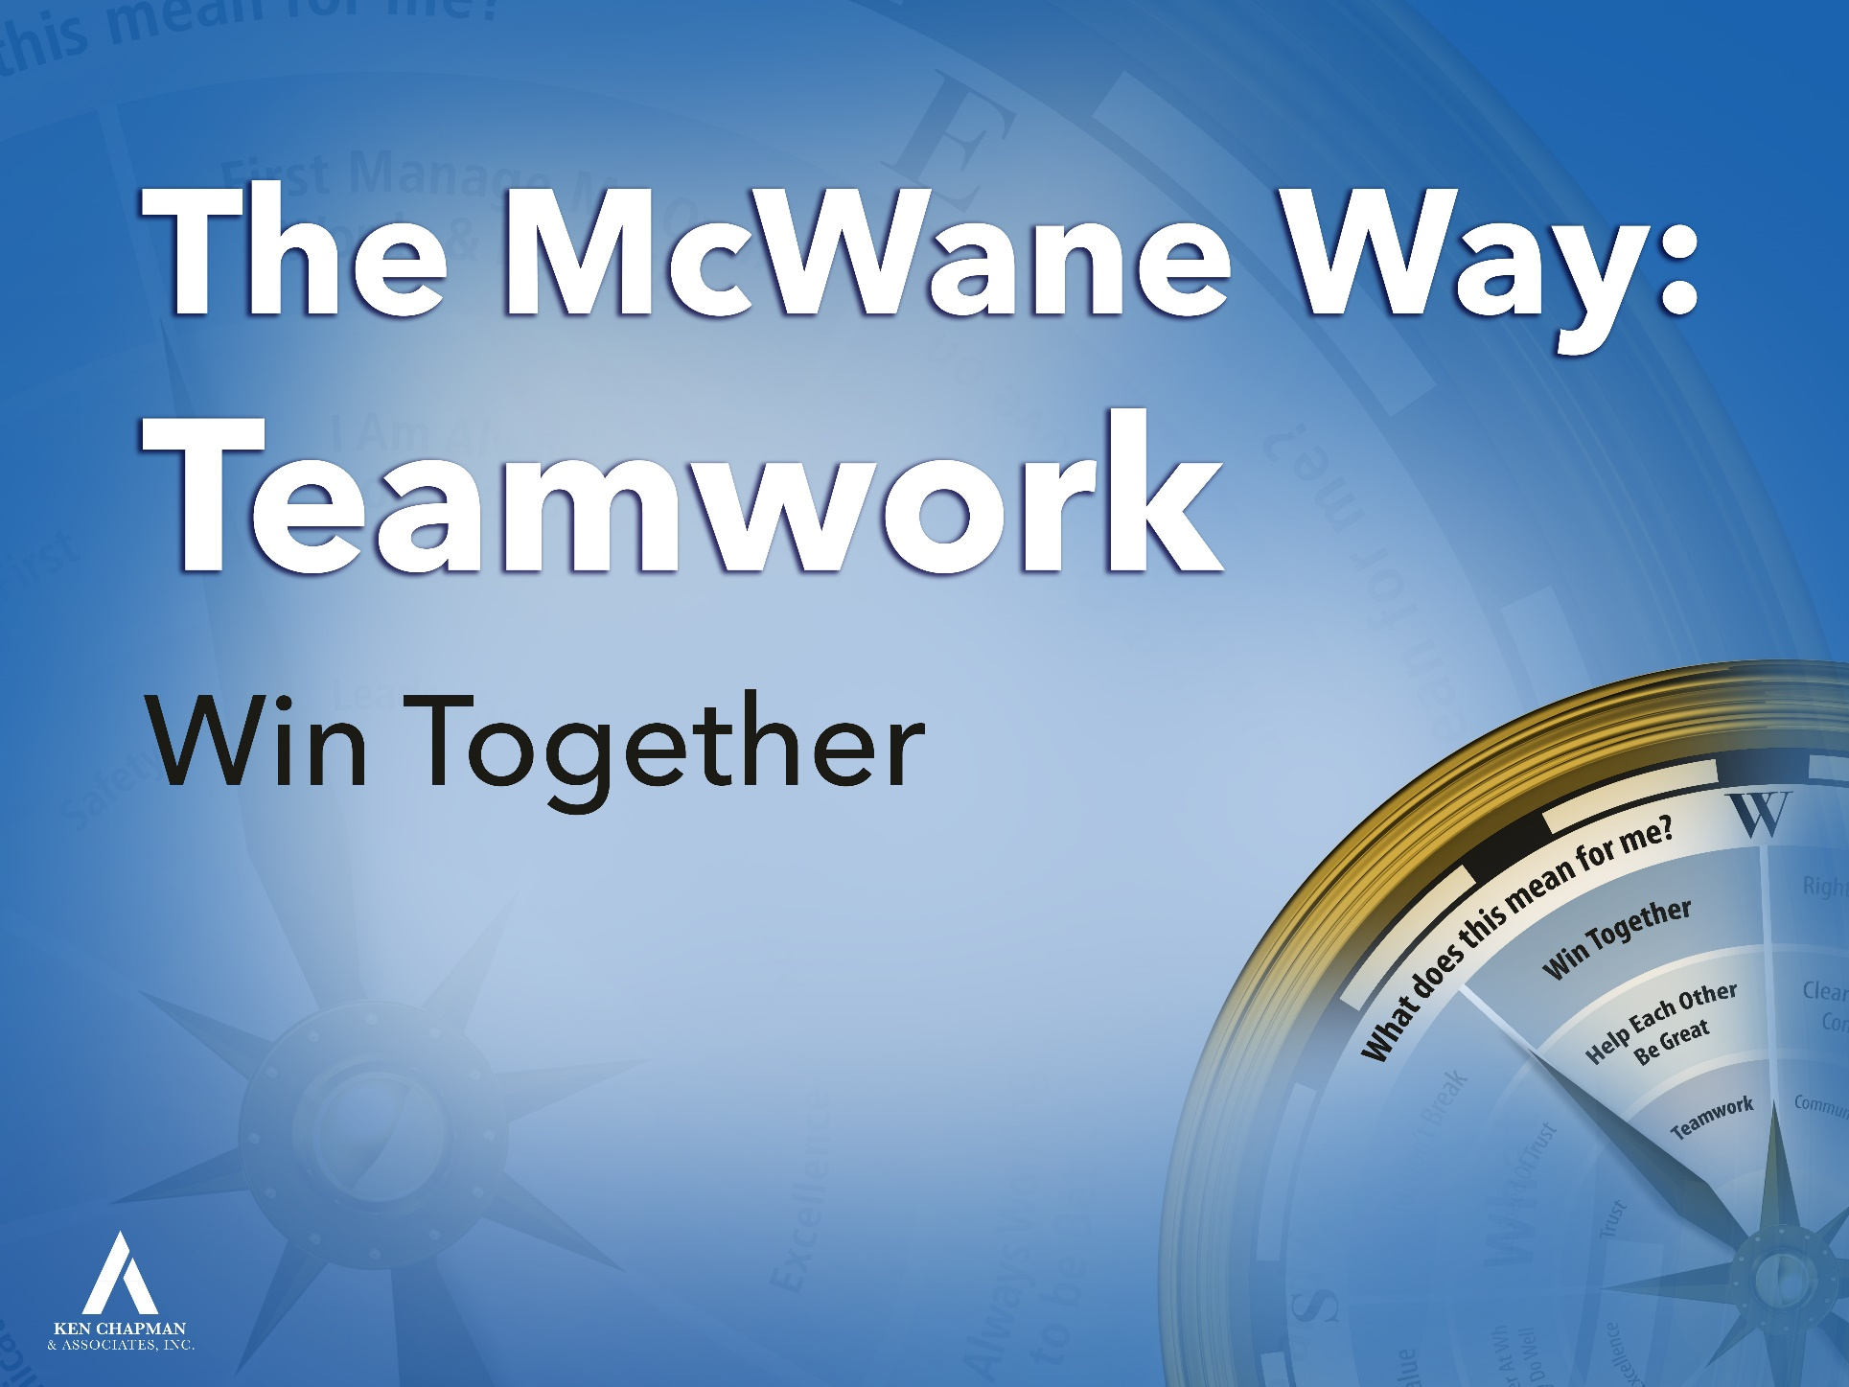
Pause for Team Discussion
Notes:
4 min., paper
Prepare a few questions of your own from the chapter. Use them to focus the discussion as each team reports.
TM should come to front of the room to provide the team’s report. One TM should read the quote while the spokesperson makes their way to the front of the room.

Slide 23
Hide the slides you will not be using.
CUP TOWER CHALLENGE #1
Slides 24-28
CUP TOWER CHALLENGE #2
Slides 29-32

Slide 24
A Team Challenge
Work with your team to build a tower exactly like the model tower that has already been built.
Each team member will have one role and one role only based on the color of the dot you chose:
SCOUT: may look at the example tower and report back to the team
BUILDER: may construct the tower using the building materials
COMMUNICATOR: may speak privately to the Communicator from another team
FACILITATOR LIAISON: may speak privately to your facilitators. (If your team only has three team members, your Communicator will also serve as the Facilitator Liaison.)
Do not open your bag until you are instructed to do so.
Your team will have 12 minutes from the announced start to successfully build your tower.
Notes:
Build the tower either before the session begins or during the break.
Ideally your tower will be located in the hall or in a neighboring room. You may want to give them 15 minutes if the “Scout” will have to travel.
If you must build your tower in the same room, have some type of partition to hide it. (We used a tri-fold presentation board.)
Place dots in front of teams during break – four dots, each a different color
After introducing the Teamwork slide, tell them we have a team challenge involving the dots.
Have team members pick a dot and place it on their nametag (if TM session) or on their shirt (if Lead Team session)
Introduce challenge
Describe roles – each color dot represents a role
It’s extremely helpful to have all the “Communicators” raise their hand or stand. Have them look around and specify that these are the only people who may talk to each other from team to team. Stress the importance of them speaking in private. You may want to indicate a dedicated area for the Communicators.
Have all the “Facilitator Liasons” raise their hands or stand so you know whom you may talk to. Remind the group that these are the only people you will communicate with.
Tell them no cell phones may be used (the Scout may try to take a picture of the tower). If they ask, the Scout can draw a picture of the tower.
Ask for questions about their roles.
Instruct them to begin and start the timer.

Slide 25
A Team Challenge
The “Take Aways”
Discuss in your teams:
Successful Team(s):
What contributed to your success?
Is there something you would do differently?
Other Teams:
What stood in the way of your success?
What would you have done differently?
Notes:
1 to 2 minutes, depending on time remaining.
Not on paper.
If not much time, don’t break into teams. Just discuss as greater team.
Winning team: What made you the winner? Is there something you would do differently?
Losing teams: What would you have done differently?

Slide 26
A Team Challenge
The “Take Aways”
The best teams:
Recognize the importance of each team member’s role
Communicate within their team
Communicate with others and learn from other teams
Share knowledge and materials
Trust that others act with goodwill and seek the common good
Recognize that the competition is not inside the gate
Are willing to give and receive help
The best teams set each other up for success and prevent failure. They Win Together.

Slide 27
A Team Challenge
The “Take Aways”
How can you apply what you’ve learned from this challenge with your team?

Slide 28
A Team Challenge
Work with your team to build a tower exactly like the model tower you will see on the next slide.
As your team builds your tower, you may only use the materials you receive.
Only the rubber band can touch the cup.
No person can touch the rubber band.
Do not begin until you are instructed to do so.
Your team will have 10 minutes from the announced start to successfully build your tower.
Notes:
In your Table Teams, you’re going to work together to build a tower.

Slide 29
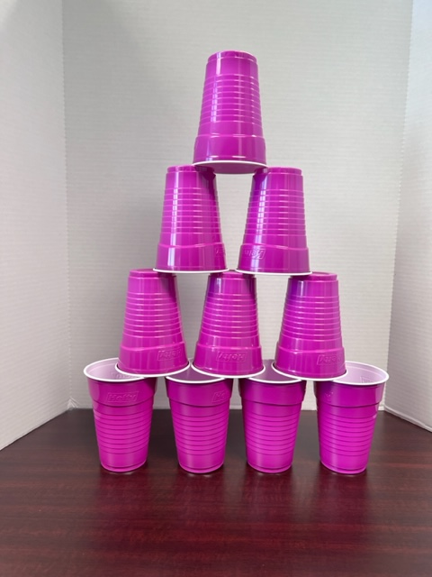
A Team Challenge
Remember: your team may only use the materials you received.
Only the rubber band can touch the cup.
No person can touch the rubber band.
Notes:
In your Table Teams, you’re going to work together to build a tower.

Slide 30
A Team Challenge
The “Take Aways”
Discuss in your teams:
Successful Team(s):
What contributed to your success?
Is there something you would do differently?
Other Team(s):
What stood in the way of your success?
What would you have done differently?
Notes:
1 to 2 minutes, depending on time remaining.
Not on paper.
If not much time, don’t break into teams. Just discuss as greater team.
Winning team: What made you the winner? Is there something you would do differently?
Losing teams: What would you have done differently?

Slide 31
A Team Challenge
The “Take Aways”
The best teams:
Recognize the importance of each team member’s contribution to the team’s success
Communicate within their team
Get along with each other
Fail forward
Innovate – think beyond the obvious
Are persistent
Ask for help
The best teams set each other up for success
and prevent failure.
They Win Together.

Slide 32
A Team Challenge
The “Take Aways”
How can you apply what you’ve learned from this challenge with your team?

Slide 33
Opportunity Assignment
To Prepare for the Next Session:
Assignment:
1. The Leader’s Code
Chapter 9 The Green Porsche
2. Leadership Development Plan
    What will I do to make it easy to get along with me?
3. Today’s Story
What is a life or leadership lesson?
Notes:
Encourage Team Members to write the information in their notebooks. (Some depend on supervisors to keep up with the dates, and this can cause frustration for all involved).
Hand out grey cards.
They need to complete the LDP ahead of the next session.
Ask if there are any questions before the story.
33

Slide 34
This presentation is the intellectual property of Ken Chapman & Associates, Inc. It may not be modified or distributed in any format without expressed written permission from
Ken Chapman & Associates, Inc.
Copyright 2024. All rights reserved.

