Slide 1

This presentation is the intellectual property of Ken Chapman & Associates, Inc. It may not be modified or distributed in any format without expressed written permission from
Ken Chapman & Associates, Inc.
Copyright 2024. All rights reserved.

Slide 2
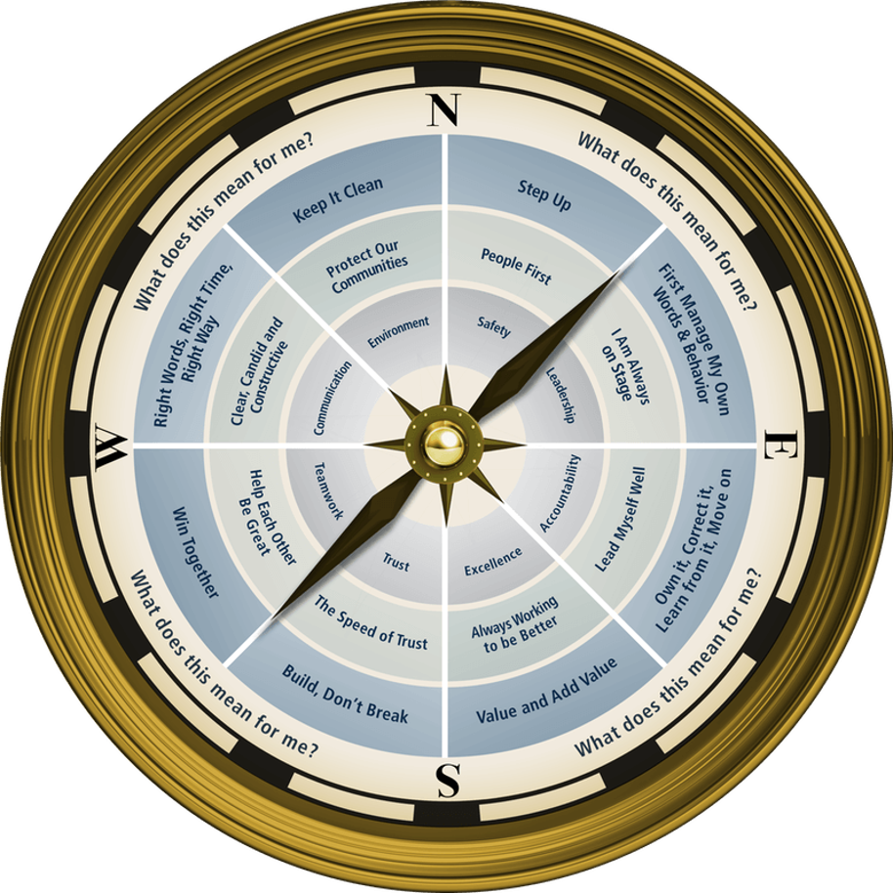

Session Six: Communicaiton
Ken Chapman and Associates, Inc. All Rights Reserved
Not Licensed for Use Outside McWane, Inc.

Slide 3


H₂O Facts

Slide 4

What percentage of the Earth’s surface is water?
61%
71%
81%
91%

Slide 5
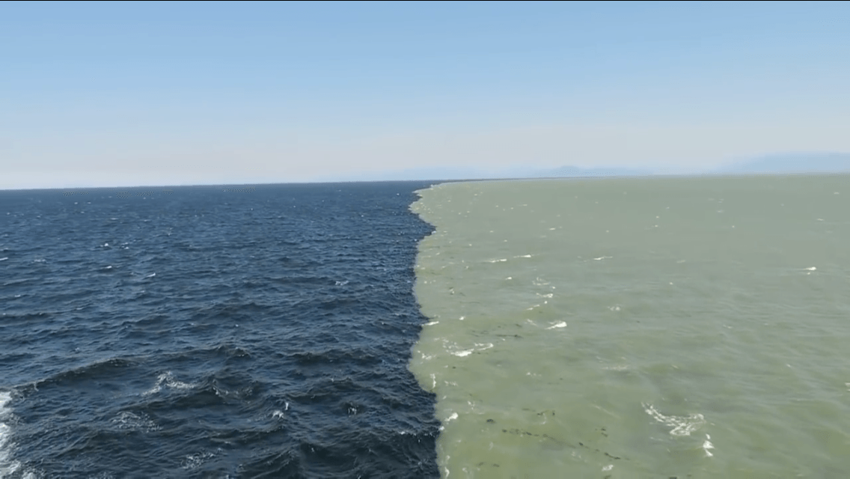
What percentage of the Earth’s water supply is salt water?
42%
75%
86%
97%
Fresh and salt water do mix, and this happens in estuaries, at mouths of rivers, and in other natural and humanmade ways.

Slide 6
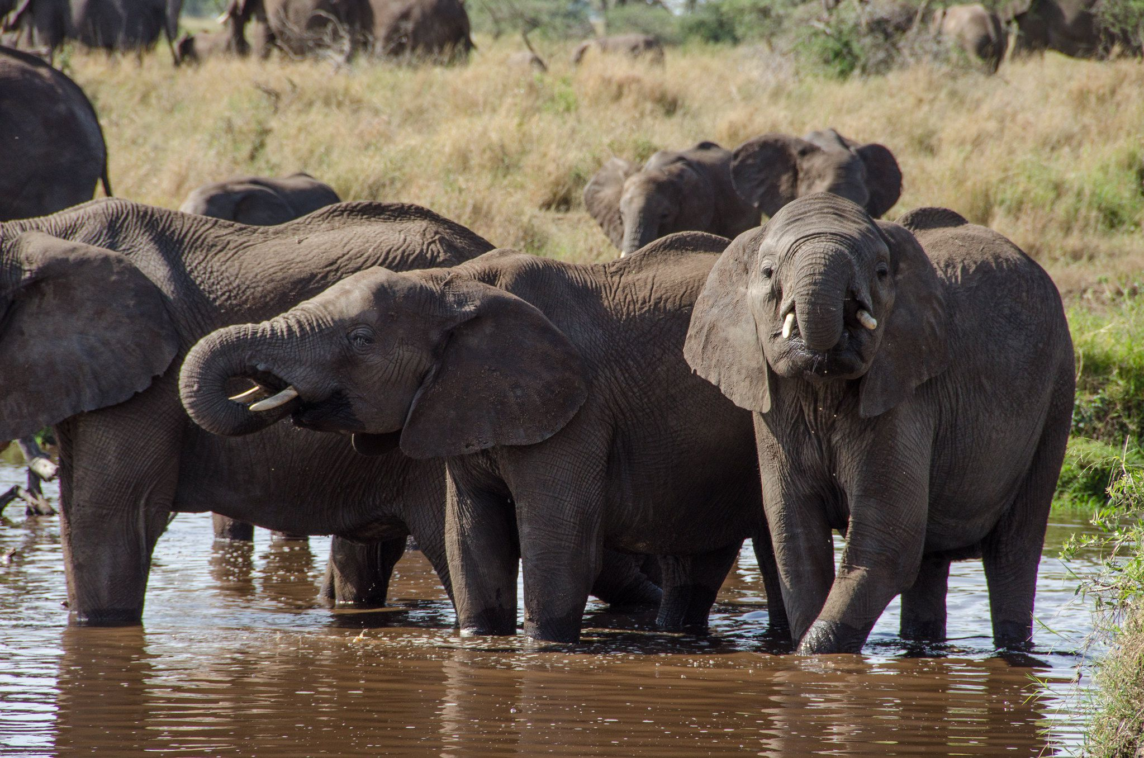
What percentage of the Earth’s water is suitable for drinking?
1%
8%
12%
20%
If you placed all of the Earth’s water from all sources – oceans, rivers, streams, lakes and glaciers – in a one-gallon jug, the amount suitable for drinking would be only 1 teaspoon.

Slide 7

How much does a gallon of water weigh?
8.37 lbs.

Slide 8
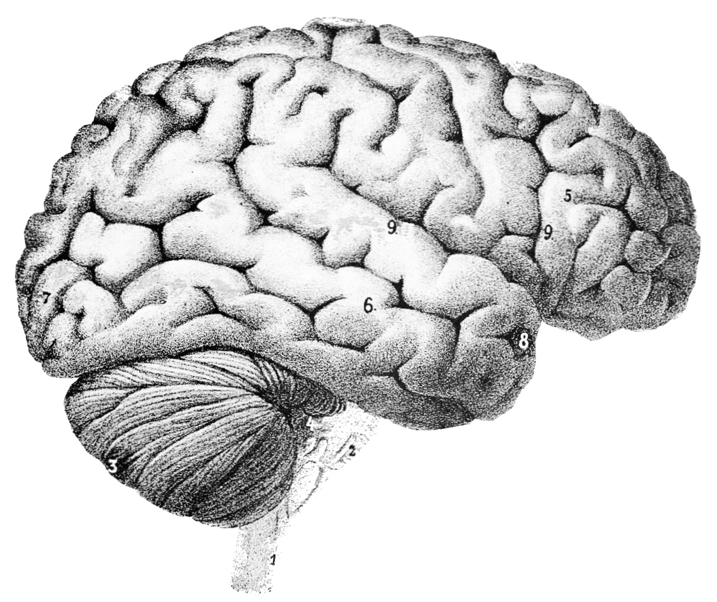
What percentage of the human brain is comprised of water?
33%
58%
60%
70%

Slide 9

How many gallons of water does
the average American household
use each year?
50,000
100,000
125,000
200,000

Slide 10


Session Standards
Confirmed in Session One
Silence cell phones
No “active” email & texting
If it’s necessary to take a call or return a message, please leave the room. Step away so your conversation does not interrupt the team discussion.
Refrain from side conversations.
Personal stories or examples shared by team members remain in this room.
Notes:
“These are your session standards that you agreed upon on (DATE).”

Slide 11
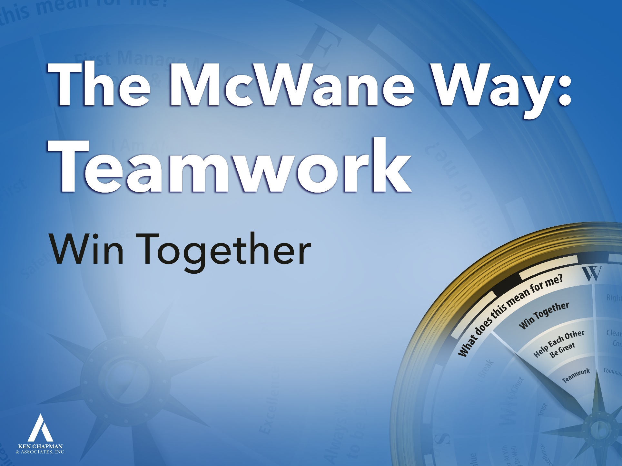
What does “Win Together”
mean to you?
Winning together means I will do everything I can to help you succeed at doing your job and I expect you to do the same to help me succeed.
The competition is outside the gate. We’re all in this together.
Notes:
The last time we were together we focused on the Teamwork Compass Point with the behavioral principle “Win Together.” In your table teams, you built spaghetti towers.
Whether your team had the winning tower or not, whether your tower stood or not, you worked together as a team. I’m guessing no one had a team member shaking the table or breaking spaghetti pieces. You all trusted each other to have the best interest of the team in mind in everything that you did.
How does that transfer to your team or department here at Clow? What does “Win Together” mean to you ?
(TAKE RESPONSES)
Click through and read two bullet points.
11

Slide 12

Leadership Development Plan:
Win Together
You were asked to set a goal from Session Five focused on “What will I do to make it easy to get along with me?”
Please briefly share your goal and how it is going.
Notes:
Ask, “Did everyone bring their gray card?” Ask them to hold up the card. Ask if anyone needs a card.
Give them one minute on the clock to finalize their plan.
OK to ask for a volunteer to begin. Once someone volunteers, stay at that table until everyone has shared.
12

Slide 13
Opportunity Assignment Roundtable:
The Leader’s Code
Pause for Team Discussion
You were asked to read Chapter 9, The Green Porsche.
Working in your teams, discuss the quote your team has been assigned.
What does this mean for you and your team?
Record your thoughts on paper.
Appoint a spokesperson for your team.
Notes:
4 min., paper
Prepare a few questions of your own from the chapter. Use them to focus the discussion as each team reports.
TM should come to front of the room to provide the team’s report. One TM should read the quote while the spokesperson makes their way to the front of the room.

Slide 14
The Leader’s Code
The Green Porsche
Quote #1
When we speak, we always run the risk of failing to communicate. Remove tone of voice, facial expression, and body language, and the failure rate rises. Emailing and texting may have added efficiency but not necessarily clarity to communication.
[Chapter 9, Page 94]
Notes:
What can we do to make sure someone understands us?
Have you ever had an email or text misinterpreted? Have you ever misinterpreted a text or email someone has sent you? What do you think we should do when we have important information to convey?

Slide 15
The Leader’s Code
The Green Porsche
Quote #2
By placing themselves in a team member’s shoes, leaders will begin to see the role emotions play in communication. This is called empathy and is a quality that can be developed by taking a genuine interest in other people. Empathy should not be confused with granting your approval, extending sympathy, or simply agreeing with another person’s point of view.
[Chapter 9, Page 96]
Notes:
Why is empathy important?
How can you show empathy without giving approval? (You can realize someone is going through a hard time…sick child at home, financial problems, etc…while still expecting them to fulfill their responsibilities.)

Slide 16
The Leader’s Code
The Green Porsche
Quote #3
Many people think being able to speak well is the most important of all communication skills….
Listening, on the other hand, tends to take second place, if any place at all. Without taking away from the importance of good verbal skills, leaders who develop their listening skills benefit a great deal. As the old saying goes, “nature has given us two ears, but only one mouth.” This may be nature’s way of telling us we should listen more than we speak.
[Chapter 9, Page 97]
Notes:
Do you think listening is a skill that must be practiced? How can you practice listening?
How do you know someone is really listening to you?

Slide 17
The Leader’s Code
The Green Porsche
Quote #4
Open listening is listening to build trust. Here we listen openly, listen to learn, suspend auto drive, and listen without judgment. What exactly does listen to learn mean? …
Listening to learn in this context means listening for only one thing: a better understanding of where the other person is coming from.
[Chapter 9, Page 99]
Notes:
Do you trust someone who you feel listens openly to you? Why?
What can you do to let someone know you’re listening to learn?

Slide 18
The Leader’s Code
The Green Porsche
Quote #5
One of the biggest barriers to listening is that many of us have learned how not to listen. It is a way to survive in the noisy world around us. We select what gets our attention. We sometimes forget to tune in again, even when we should, since tuning out is a natural and comfortable habit. Listening is work, but it is worth the effort.
[Chapter 9, Page 99]
Notes:
Why do you think we “tune out”? What has trained us to do that?
What can we do to consciously tune back in?

Slide 19
The Leader’s Code
The Green Porsche
Quote #6
Summarizing is necessary in those situations where you have to understand exactly what is said. When the speaker comes to a natural pause after finishing a point, paraphrase what he or she said. Begin with a summary of the phrase such as, “This is what I heard you say,” or, “My understanding of what you said is….” Then ask the speaker if what you heard is correct.
[Chapter 9, Page 103]
Notes:
What’s an example of a time when it would be helpful to summarize what you heard the other person say?
Is it appropriate to ask someone else what they heard you say? How would you do that?

Slide 20

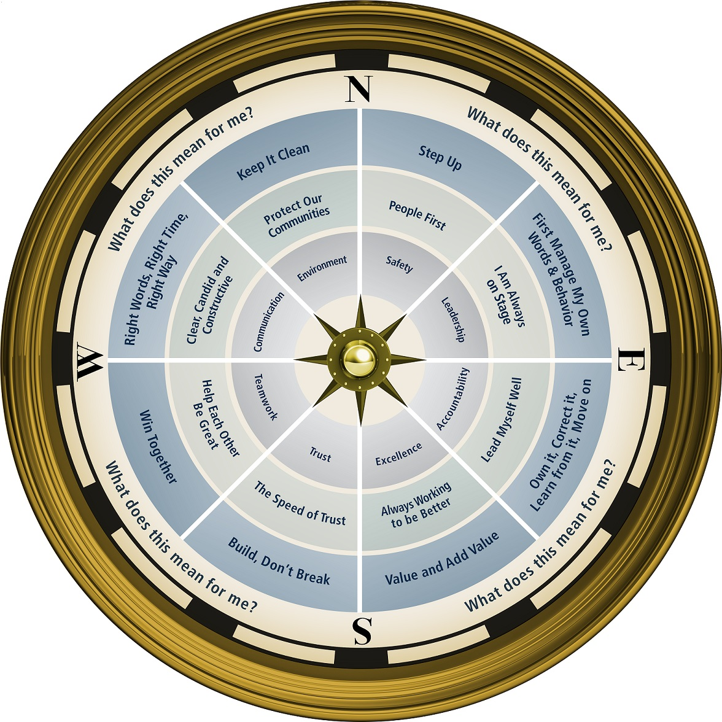

Notes:
7 MINUTE BREAK

Slide 21
Pause for Team Discussion
Impressions
Base your assumptions on what the person
“looks like.”
Guess the person’s
  Name
  Age
  Marital status
  Educational background
  Occupation
  Appoint a spokesperson for your team.

Slide 22
Impressions
Choose one person
(two slides – before and after)
to use for the session and either hide or delete the remaining slides for the people.

Slide 23
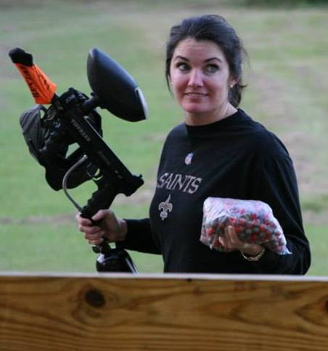
Impressions
Base your assumptions on what the person
“looks like.”
Guess the person’s
  Name
  Age
  Marital status
  Educational background
  Occupation
  Appoint a spokesperson for your team.

Slide 24
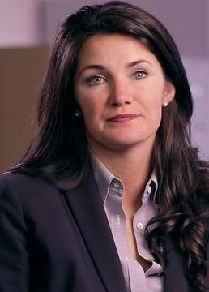
Impressions: How Did You Do?
Anna-Marie Morton
32 years old
Married/1 child
B.S., Business
Realtor

Slide 25
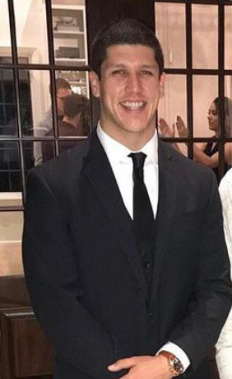
Impressions
Base your assumptions on what the person
“looks like.”
Guess the person’s
  Name
  Age
  Marital status
  Educational background
  Occupation
  Appoint a spokesperson for your team.

Slide 26
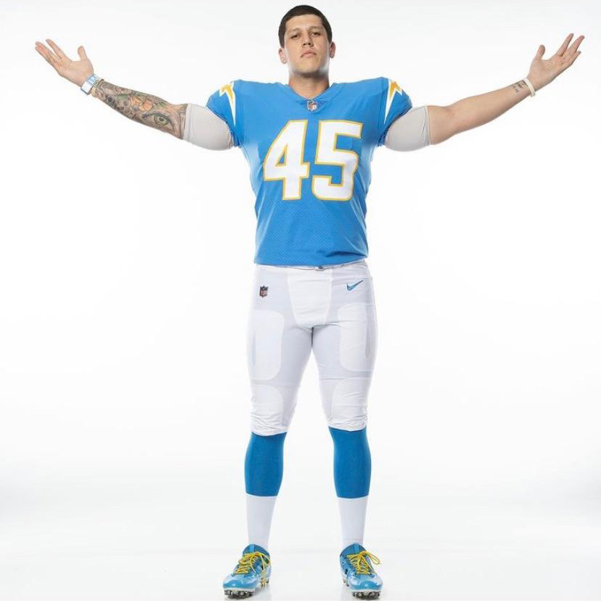
Impressions: How Did You Do?
Cole Mazza
25
Single
B.S., Kinesiology
Professional Football Player: Longsnapper for LA Chargers

Slide 27
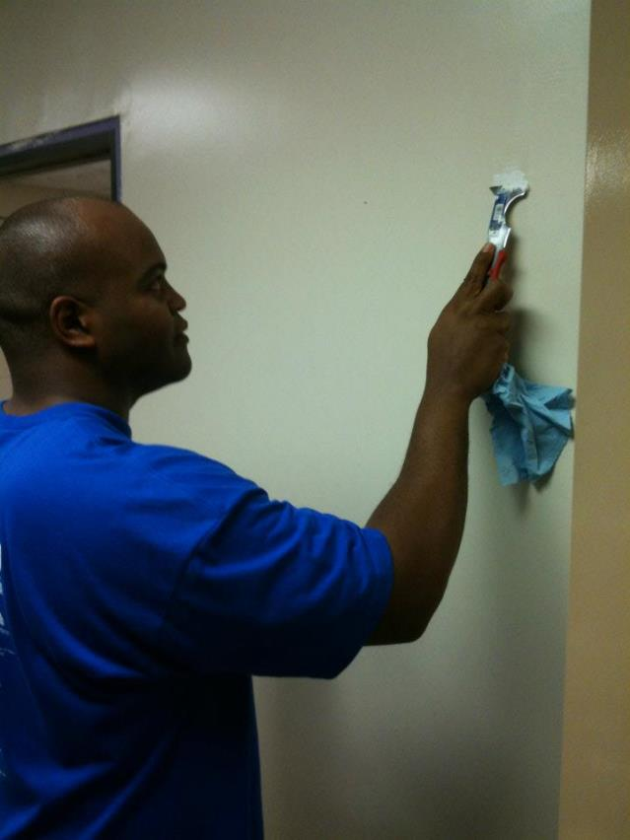
Impressions
Base your assumptions on what the person
“looks like.”
Guess the person’s
  Name
  Age
  Marital status
  Educational background
  Occupation
  Appoint a spokesperson for your team.

Slide 28
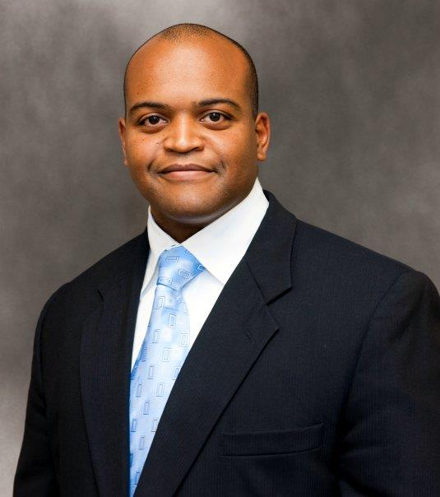
Impressions: How Did You Do?
Tommie Adams
37 years old
Married/8 children
B.S., Finance
Financial Advisor

Slide 29
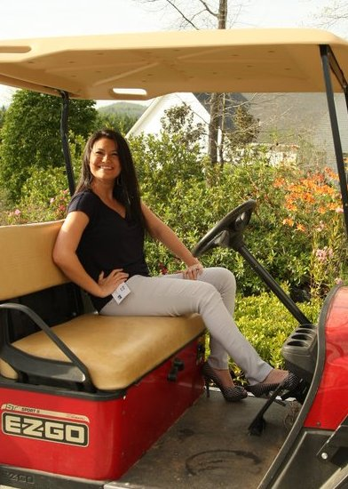
Impressions
Base your assumptions on what the person
“looks like.”
Guess the person’s
  Name
  Age
  Marital status
  Educational background
  Occupation
  Appoint a spokesperson for your team.

Slide 30
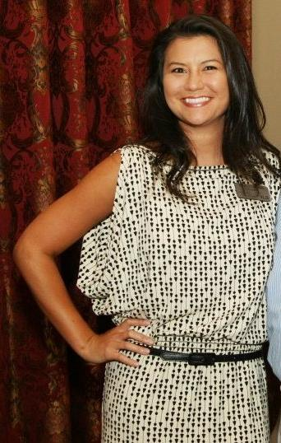
Impressions: How Did You Do?
Misty Stewart
31 years old
Married/one dog
B.S., Marketing
Marketing VP for a logistics/trucking company

Slide 31
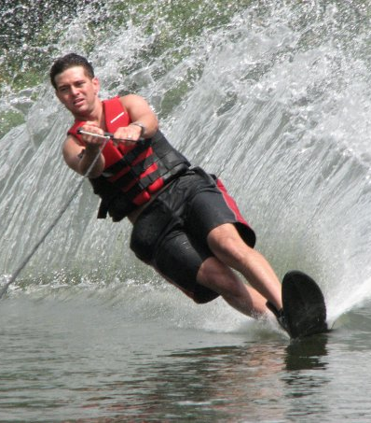
Impressions
Base your assumptions on what the person
“looks like.”
Guess the person’s
  Name
  Age
  Marital status
  Educational background
  Occupation
  Appoint a spokesperson for your team.

Slide 32
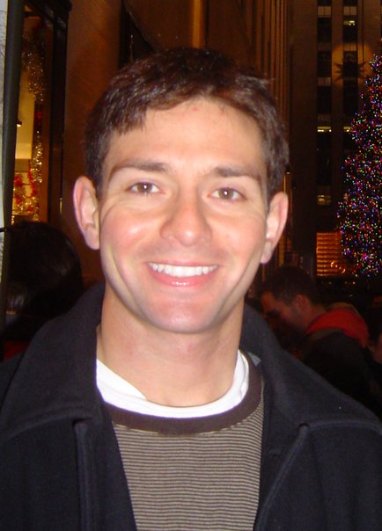
Impressions: How Did You Do?
Hamid Tehrani
34 years old
Married/2 children
B.S., Computer Science
Manages his wife’s dental practice

Slide 33
Opportunity Assignment
To Prepare for the Next Session:
Assignment:
1. The Leader’s Code
Chapter 7 The Common Good
2. Leadership Development Plan
    How will I use Right Words, Right Time, Right Way?
3. Today’s Story
What is a life or leadership lesson?
Notes:
Encourage Team Members to write the information in their notebooks. (Some depend on supervisors to keep up with the dates, and this can cause frustration for all involved).
Hand out grey cards.
They need to complete the LDP ahead of the next session.
Ask if there are any questions before the story.
33

Slide 34
This presentation is the intellectual property of Ken Chapman & Associates, Inc. It may not be modified or distributed in any format without expressed written permission from
Ken Chapman & Associates, Inc.
Copyright 2024. All rights reserved.

