Slide 1

This presentation is the intellectual property of Ken Chapman & Associates, Inc. It may not be modified or distributed in any format without expressed written permission from
Ken Chapman & Associates, Inc.
Copyright 2024. All rights reserved.

Slide 2
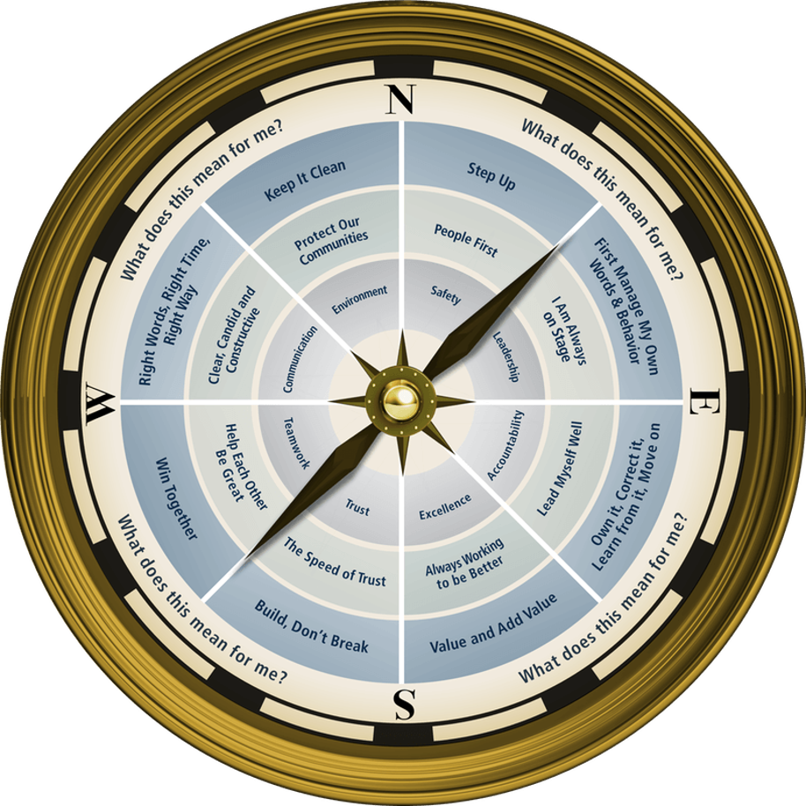

Session Seven: Safety
Ken Chapman and Associates, Inc. All Rights Reserved
Not Licensed for Use Outside McWane, Inc.

Slide 3


Safety Facts
Ken Chapman & Associates, Inc. All Rights Reserved
Not Licensed for Use Outside McWane, Inc.

Slide 4
What is the #1 Cause of Workplace Injuries in the Workplace?
Slips and Falls
Overexertion
Substance Abuse
Equipment Malfunction
Overexertion – lifting, pushing, pulling, carrying – accounts for 25% of workplace injuries.
Ken Chapman & Associates, Inc. All Rights Reserved
Not Licensed for Use Outside McWane, Inc.

Slide 5
How many persons died in workplace incidents in 2022*?
7,848
12,342
5,486
6,783
Represents a 5.7% increase from 5,190 in 2021. A worker died every 96 minutes in 2022.
*2023 data will be released in December of 2024.
Ken Chapman & Associates, Inc. All Rights Reserved
Not Licensed for Use Outside McWane, Inc.

Slide 6
Prior to the formation of OSHA, how many workplace deaths occurred annually?
10,000
14,000
22,000
30,000
Worker deaths in America are down-on average, from about 38 worker deaths a day in 1970 to 15 a day in 2022.
Ken Chapman & Associates, Inc. All Rights Reserved
Not Licensed for Use Outside McWane, Inc.

Slide 7
Around 102,000 unintentional deaths occur in homes each year according to the most recent data. What is the #1 cause?
Poisoning
Falls
Fires and burns
Choking
Over 98,000 deaths were a result of drug overdoses in 2022.
Ken Chapman & Associates, Inc. All Rights Reserved
Not Licensed for Use Outside McWane, Inc.

Slide 8
Dehydration can be a factor in unintentional injuries. Dehydration can result in:
Rapid pulse
Low blood pressure
Dizziness or light-headedness
Reduction in concentration and alertness
All of the above
As little as 5% dehydration can result in a 30-40% reduction in concentration and alertness.
Ken Chapman & Associates, Inc. All Rights Reserved
Not Licensed for Use Outside McWane, Inc.

Slide 9
In the United States, an average of 9 deaths and 1,000 injuries a day are a result of what activity?
Extreme sports
Distracted driving
Yardwork
Home repairs
If you’re driving 55 mph and you take your eyes off the road for 5 seconds to read or send a text message, adjust the radio, or get that last French fry out of the bottom of the bag, you will travel the length of a football field.
Ken Chapman & Associates, Inc. All Rights Reserved
Not Licensed for Use Outside McWane, Inc.

Slide 10
Comprehensive workplace safety programs have proven to decrease injuries by:
90%
75%
50%
25%
Ken Chapman & Associates, Inc. All Rights Reserved
Not Licensed for Use Outside McWane, Inc.

Slide 11



Session Standards
Confirmed in Session One
Silence cell phones
No “active” email & texting
If it’s necessary to take a call or return a message, please leave the room. Step away so your conversation does not interrupt the team discussion.
Refrain from side conversations.
Personal stories or examples shared by team members remain in this room.
Ken Chapman & Associates, Inc. All Rights Reserved
Not Licensed for Use Outside McWane, Inc.
Notes:
“These are your session standards that you agreed upon on in our first session.”

Slide 12
Opportunity Assignment Roundtable:
The Leader’s Code
Pause for Team Discussion
You were asked to read Chapter 7, The Common Good.
Working in your teams, respond to the question your team has been assigned.
What does this mean for you and your team?
Record your thoughts on paper.
Appoint a spokesperson for your team.
Ken Chapman & Associates, Inc. All Rights Reserved
Not Licensed for Use Outside McWane, Inc.

Slide 13
The Leader’s Code
The Common Good
Roundtable Discussion #1
When does a team member’s disruptive or disrespectful behavior cross the line and need to be addressed?
Ken Chapman & Associates, Inc. All Rights Reserved
Not Licensed for Use Outside McWane, Inc.
Notes:
13

Slide 14
The Leader’s Code
The Common Good
Roundtable Discussion #2
Bad team members can hide in a crowd. That crowd is almost always made up of good team members.
What does this mean to you and your team?
Ken Chapman & Associates, Inc. All Rights Reserved
Not Licensed for Use Outside McWane, Inc.
Notes:
14

Slide 15
The Leader’s Code
The Common Good
Roundtable Discussion #3
What are some behaviors that are wrong in the workplace?
Ken Chapman & Associates, Inc. All Rights Reserved
Not Licensed for Use Outside McWane, Inc.
Notes:
15

Slide 16
The Leader’s Code
The Common Good
Roundtable Discussion #4
What can your team member do that would make your
day easier?
Ken Chapman & Associates, Inc. All Rights Reserved
Not Licensed for Use Outside McWane, Inc.
Notes:
16

Slide 17
The Leader’s Code
The Common Good
Roundtable Discussion #5
What can you do to make your team member’s day easier?
Ken Chapman & Associates, Inc. All Rights Reserved
Not Licensed for Use Outside McWane, Inc.
Notes:
17

Slide 18
The Leader’s Code
The Common Good
Roundtable Discussion #6
Everyone says they don’t want anyone to get hurt.
Is it enough to say you don’t want anyone to get hurt or do you have to be willing to speak up even when you’re uncomfortable or you’re worried someone may dislike you for speaking up?
Are you really committed to safety if you won’t speak up?
Ken Chapman & Associates, Inc. All Rights Reserved
Not Licensed for Use Outside McWane, Inc.
Notes:
18

Slide 19

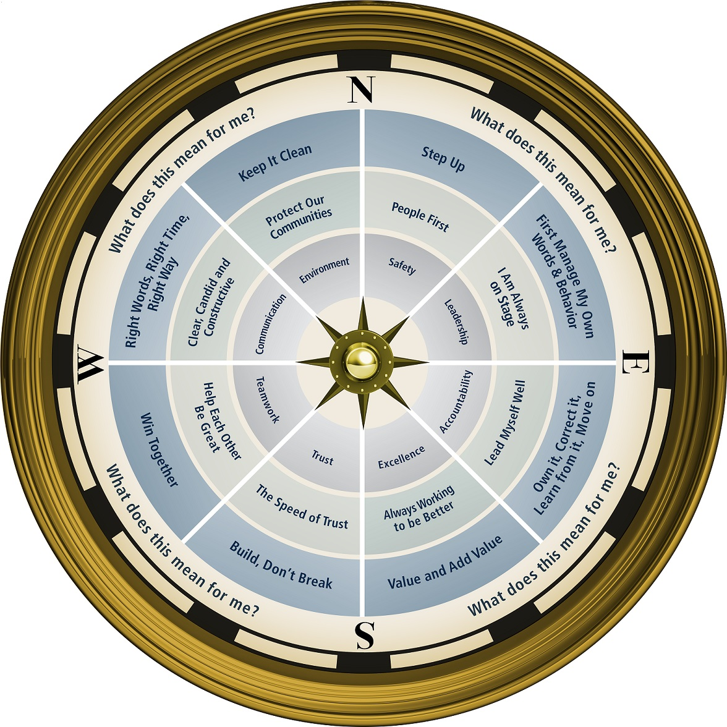

Ken Chapman & Associates, Inc. All Rights Reserved
Not Licensed for Use Outside McWane, Inc.
Notes:
19

Slide 20
Opportunity Assignment
To Prepare for the Next Session:
Assignment:
1. The Leader’s Code
Chapter 13, The Correct Story
2. Leadership Development Plan
    What can I do to show my team members I’m in the
    green?
3. Personal Challenge
4. Today’s Story
What is a life or leadership lesson?
Ken Chapman & Associates, Inc. All Rights Reserved
Not Licensed for Use Outside McWane, Inc.
Notes:
20

Slide 21
This presentation is the intellectual property of Ken Chapman & Associates, Inc. It may not be modified or distributed in any format without expressed written permission from
Ken Chapman & Associates, Inc.
Copyright 2024. All rights reserved.

