Slide 1

This presentation is the intellectual property of Ken Chapman & Associates, Inc. It may not be modified or distributed in any format without expressed written permission from
Ken Chapman & Associates, Inc.
Copyright 2024. All rights reserved.

Slide 2
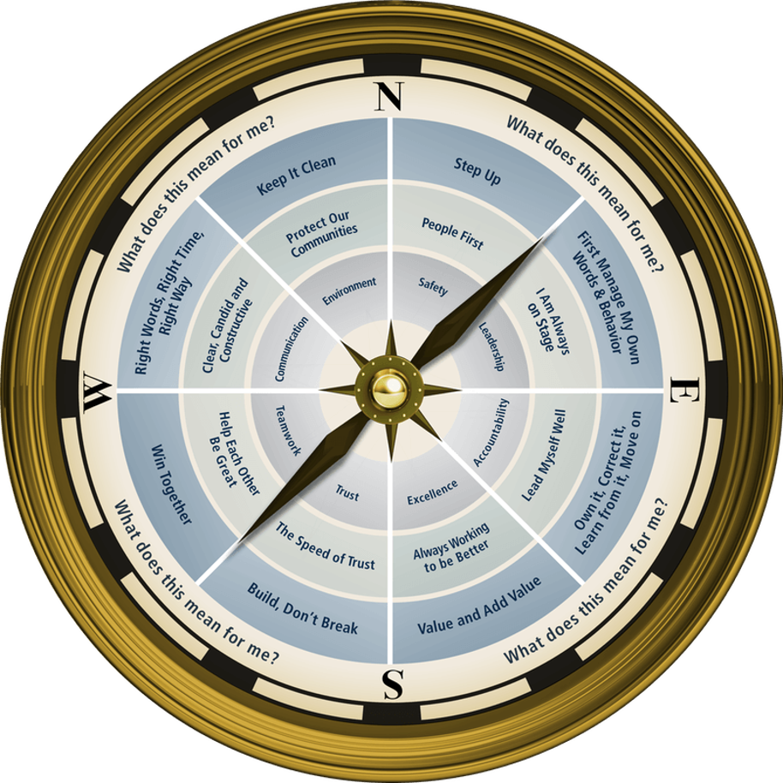

Session Eight: Environment
Ken Chapman and Associates, Inc. All Rights Reserved
Not Licensed for Use Outside McWane, Inc.

Slide 3


Environmental Facts
Ken Chapman & Associates, Inc. All Rights Reserved
Not Licensed for Use Outside McWane, Inc.

Slide 4
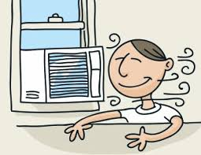

What uses the most energy in your home?
A. Stove
B. Hot Water Heater
C. Heat/Air Conditioning
D. Lights

Slide 5
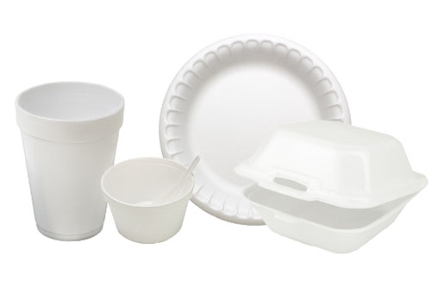
How long does it take Styrofoam products to decompose in a landfill?
A. 10 Years
B. 2 Months
C. 400 Years
D. 150 Years
Notes:
Obviously, Styrofoam hasn’t been around for 400 years, but that’s the estimate based on the rate of decomposition that has been observed.

Slide 6
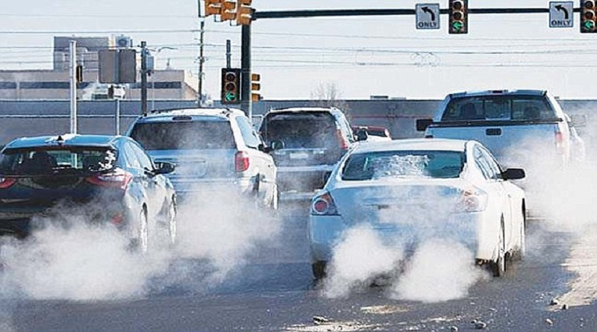
What percentage of total air pollution comes from motor vehicles?
A. 25%
B. 50%
C. 75%
D. 95%

Slide 7
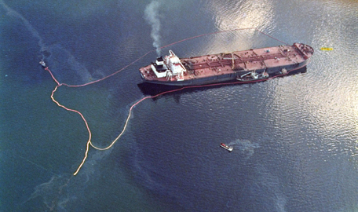
Where did the Exxon Valdez oil spill happen?
A. Alaska
B. Maine
C. Florida
D. Mexico
The Exxon Valdez oil spill occurred in the Prince William Sound on March 23, 1989. It is considered one of the most devastating human-caused environmental disasters ever to occur at sea.
Notes:
It ranks well down on the list of the world's largest oil spills in terms of volume released. However, Prince William Sound's remote location (accessible only by helicopter and boat) made government and industry response efforts difficult.

Slide 8
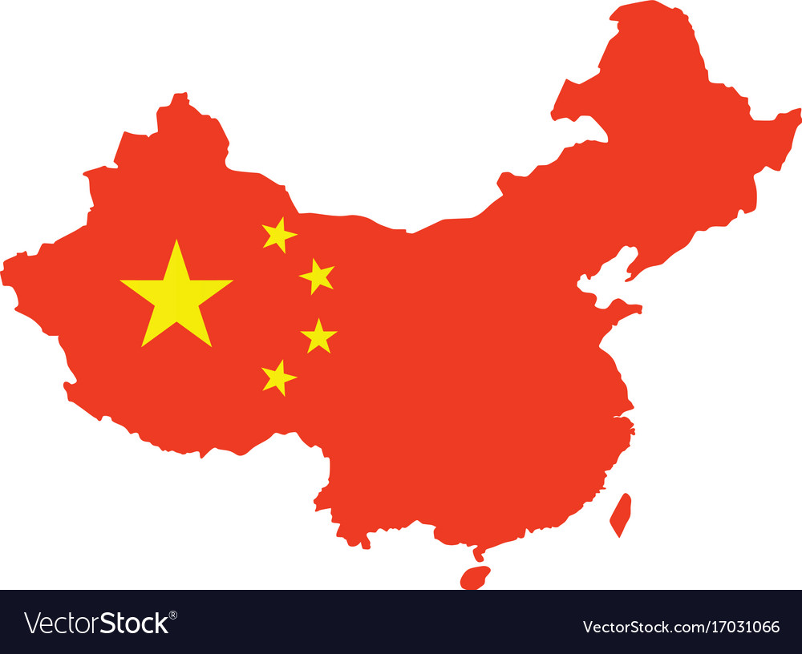
What country produces the most energy in the world?
A. Iraq
B. China
C. The United States
D. Russia
China produces the most, about 79.1 quadrillion BTU of energy a year.
Notes:
They also use the most.

Slide 9
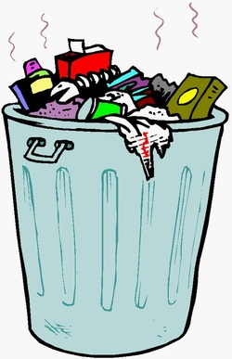
How much trash does the average American generate per day?
3 lbs.
4 lbs.
8 lbs.
10 lbs.

Slide 10
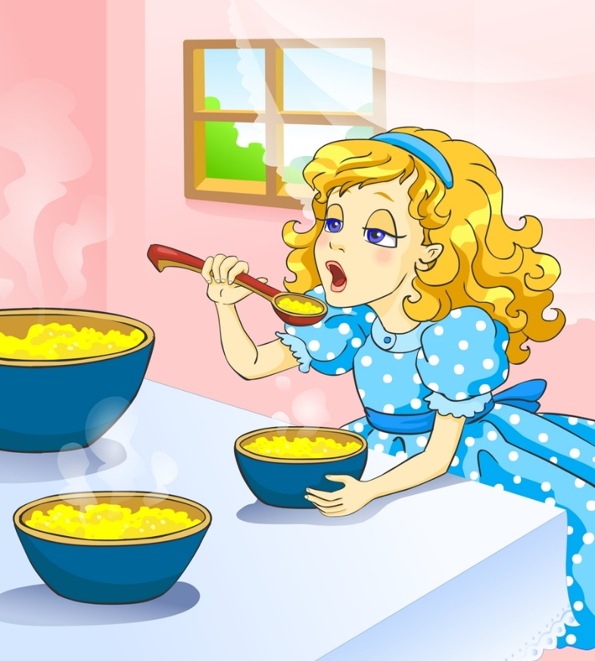
Earth is called a ‘Goldilocks planet’ because:
A. It has bears on it.
B. Porridge is a healthy
breakfast.
C. Its distance from the sun
is ‘just right’ for life.
D. Scientists don’t refer to Earth
this way.
A Goldilocks planet falls within a star’s habitable zone and is neither too close nor too far from a star to rule out liquid water on its surface, and thus life.

Slide 11



Session Standards
Confirmed in Session One
Silence cell phones
No “active” email & texting
If it’s necessary to take a call or return a message, please leave the room. Step away so that your conversation does not interrupt the team discussion.
Refrain from side conversations.
Personal stories or examples shared by team members remain in this room.

Slide 12

Pause for Team Discussion
What does it mean for me?
Working in your teams, discuss the McWane Way Compass Point your team has been assigned.
Pay close attention to the behavioral principle.
What does this mean for you and your team?
Record your thoughts on paper.
Appoint a spokesperson for your team.
Notes:
12

Slide 13

Notes:
13
Table Team Handout:

Slide 14

Notes:
Table Team handout:

Slide 15

Notes:
15
Table Team handout:

Slide 16
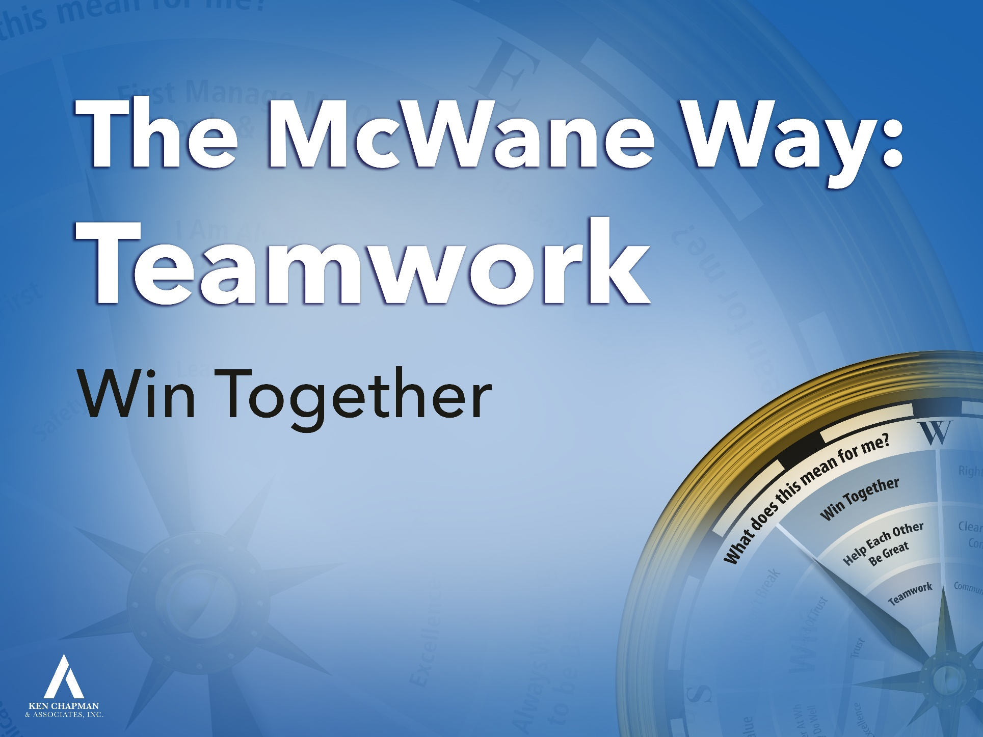
Notes:
Table Team handout:

Slide 17

Notes:
**If you have 6 teams, assign the Communication Compass Point to two teams.
Table Team handout:

Slide 18
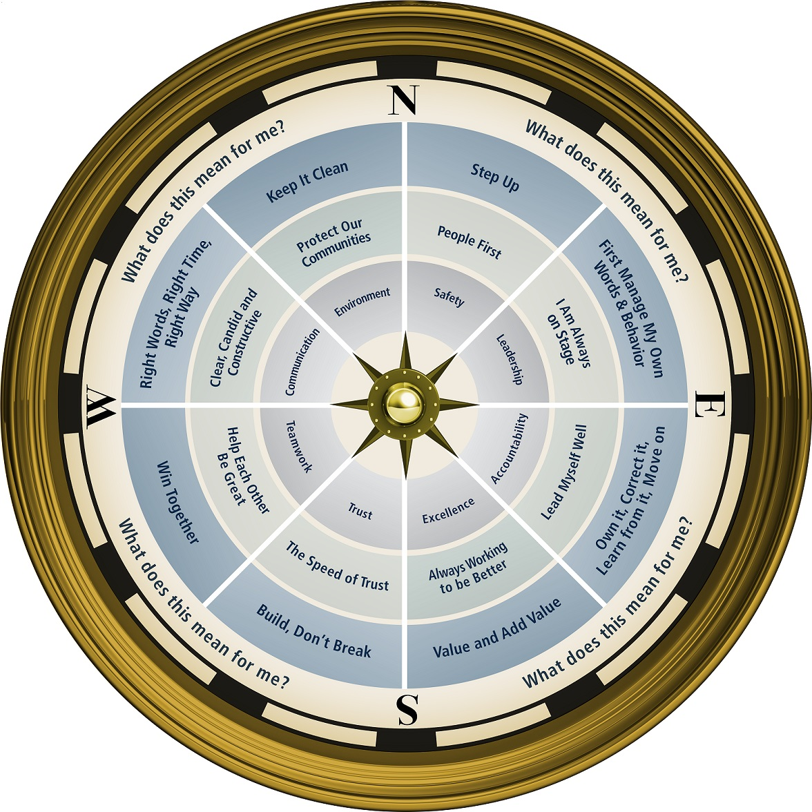

Notes:
Set Timer Tools for 7 minutes and give the participants a break.

Slide 19
Pause for Team Discussion
Feedback for the Environmental Team
Working in your teams, create a chart like the one below.
List items you think your Environmental Team should keep doing, start doing, or stop doing.
Appoint a spokesperson for your team.
KEEP
START
STOP
Notes:
Think about the environmental guidelines and procedures you see and experience around you.
___ is going to give you a full piece of flipchart paper with this chart drawn on it.
We’ll have ___ from the Environmental Team to address and respond to your suggestions.
19

Slide 20
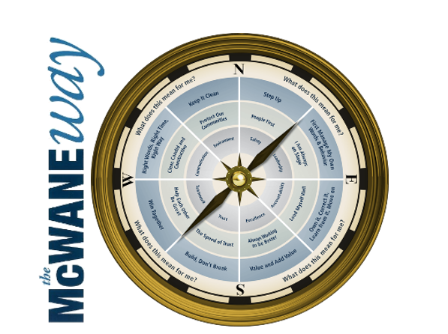
Leadership:
Accountability:
Excellence:
Trust:
Teamwork:
Communication:
Safety:
Environment:
First Manage My Own Words and Behavior
Own It, Correct It, Learn from It, Move On
Value and Add Value
Build, Don’t Break
Win Together
Right Words, Right Time, Right Way
Step Up
Keep It Clean
Notes:
20

Slide 21
Personal Challenge
Share your influential person with the team.
  Who has been one of the most influential people in my life? (This person may be a parent, an associate, a friend, a family member, or a neighbor.)
  Which of his or her qualities do I most admire?
  What qualities have I gained (or do I hope to gain) from that person?

Slide 22

Graduation

Slide 24
This presentation is the intellectual property of Ken Chapman & Associates, Inc. It may not be modified or distributed in any format without expressed written permission from
Ken Chapman & Associates, Inc.
Copyright 2024. All rights reserved.

