Slide 1
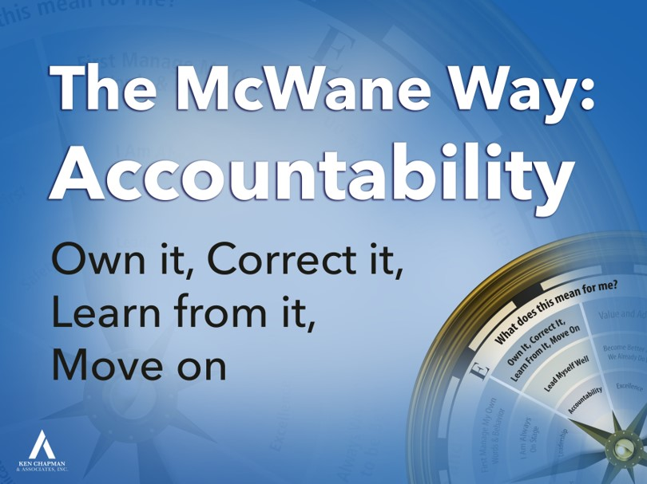

Nobody’s perfect and we all make mistakes,
but how will I handle it when I make a mistake?
A stand-up person practices O.C.L. and M.
What does this mean for me?
Ken Chapman & Associates, Inc. All Rights Reserved
Not Licensed for Use Outside McWane, Inc.
Notes:
1

Slide 2
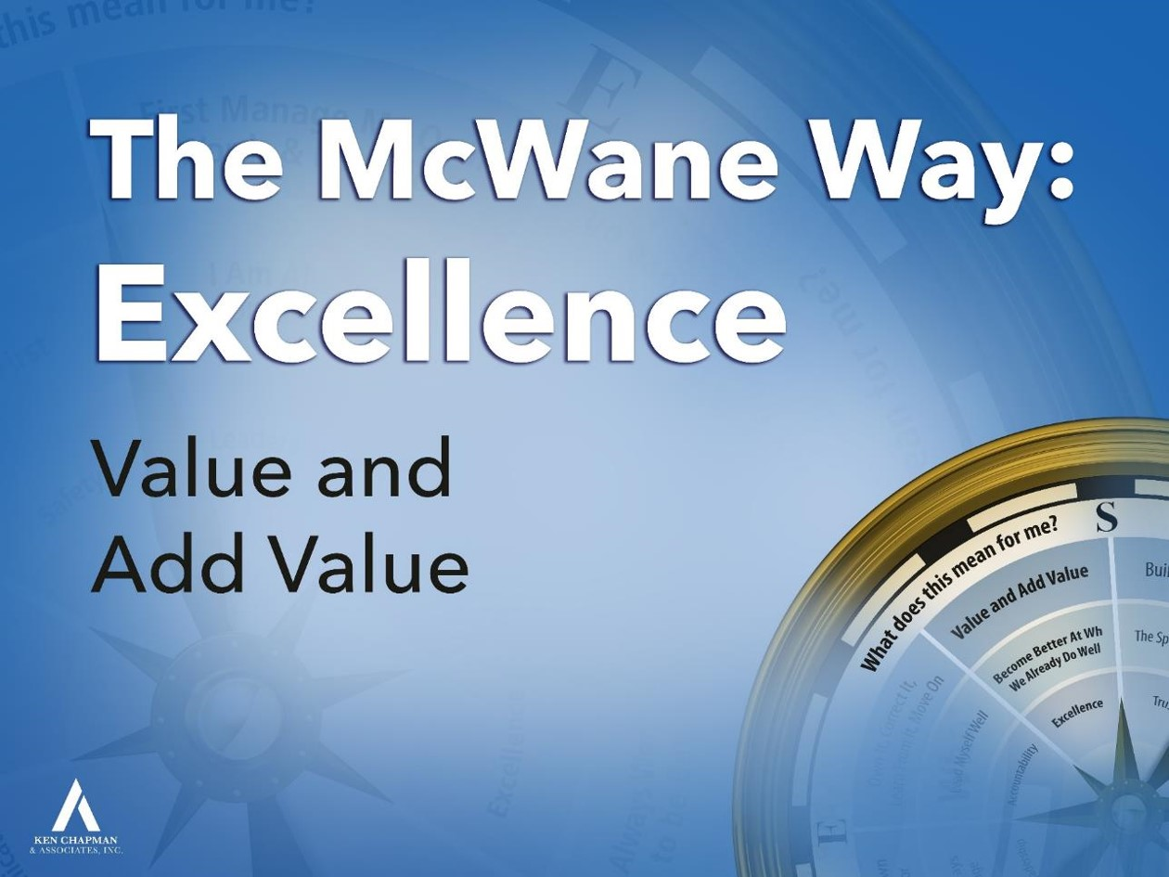
Everyone has value to add here.
Adding value means recognizing what is good and
striving to make it better to meet the
rising expectations of the customer.
What does this mean for me?
Ken Chapman & Associates, Inc. All Rights Reserved
Not Licensed for Use Outside McWane, Inc.

Slide 3
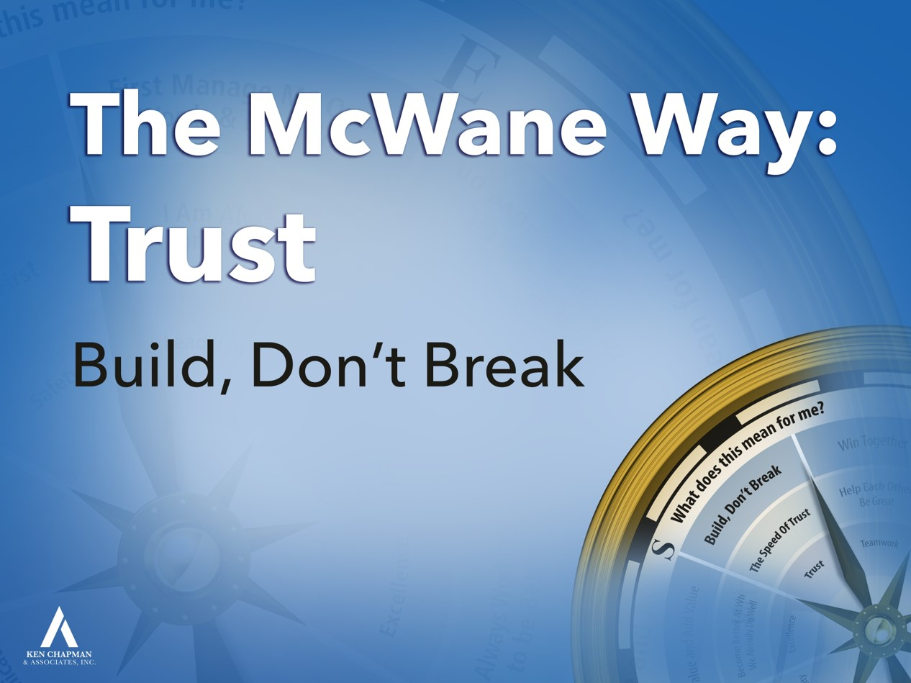
Every conversation and action is either
building and maintaining trust or breaking trust.
The question I need to ask myself is not
“Who can I trust?” but instead is “Who can trust me?”
What does this mean for me?
Ken Chapman & Associates, Inc. All Rights Reserved
Not Licensed for Use Outside McWane, Inc.
Notes:
3

Slide 4
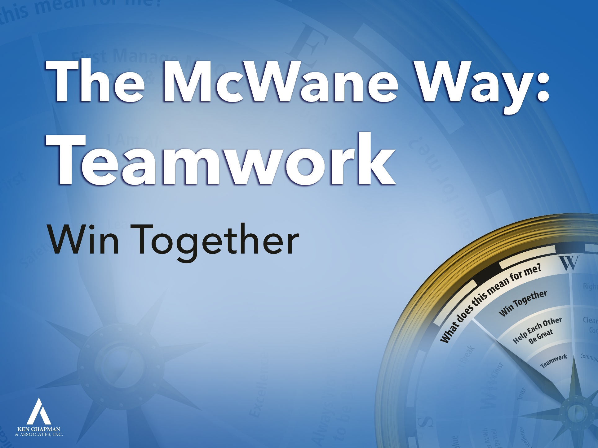
Winning together means I will do everything
I can to help you succeed at doing your job
and I expect you to do the same to help me succeed.
The competition is outside the gate. We’re all in this together.
What does this mean for me?
Ken Chapman & Associates, Inc. All Rights Reserved
Not Licensed for Use Outside McWane, Inc.

Slide 5
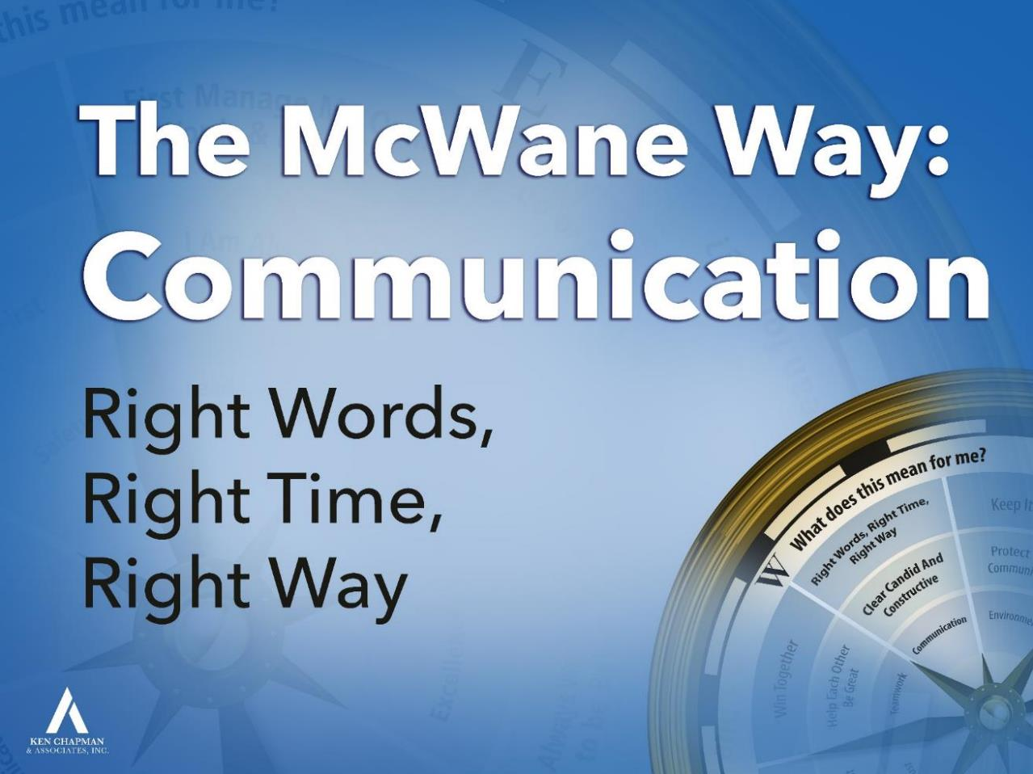
Anything that needs to be said can be said using the Right Words at the Right Time in the Right Way.
What does this mean for me?
Ken Chapman & Associates, Inc. All Rights Reserved
Not Licensed for Use Outside McWane, Inc.

